Slide 1






GET Buddied Up
German with Ali, the Eagle
get-across-borders@uni-mainz.de
© 2020 - GET Across Borders

Slide 2
Deutsch lernen mit Ali, unserem Adler
Sigrid Rieuwerts get-across-borders@uni-mainz.de

Slide 3

Herzlich willkommen!
Today we will talk about…
hobbies
and sports
© GET Across Borders

Slide 4
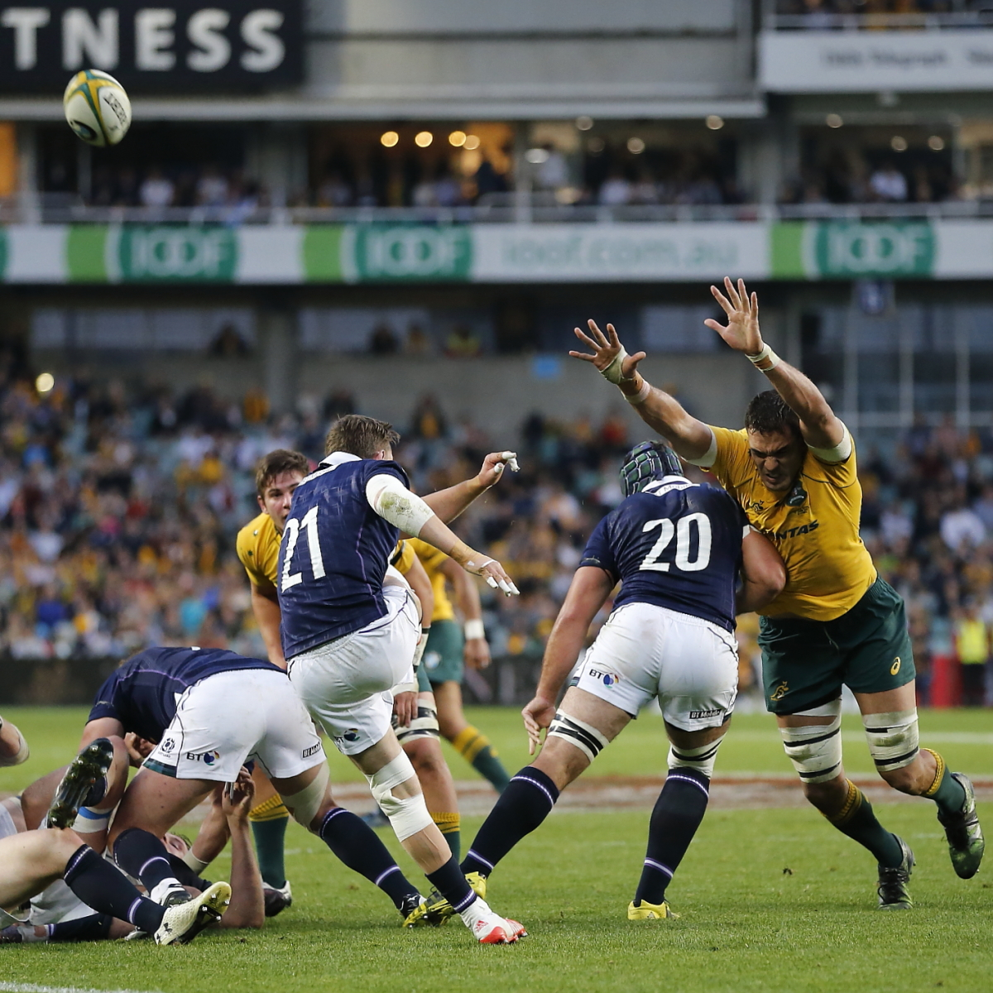
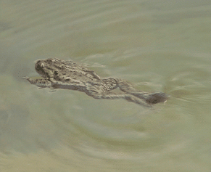
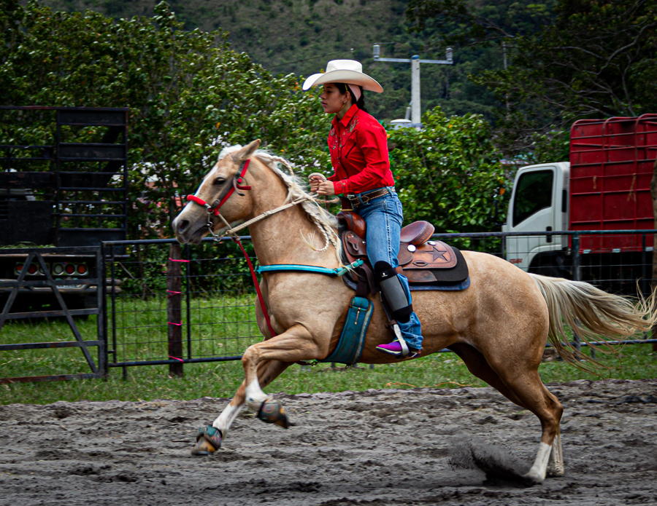
Hobbys
Rugby spielen schwimmen reiten
Ich spiele Rugby. Ich schwimme. Ich reite.
© David Molloy / Wikimedia
© Ervín Pospíšil / Wikimedia
© Franhogan / Wikimedia
© GET Across Borders

Slide 5

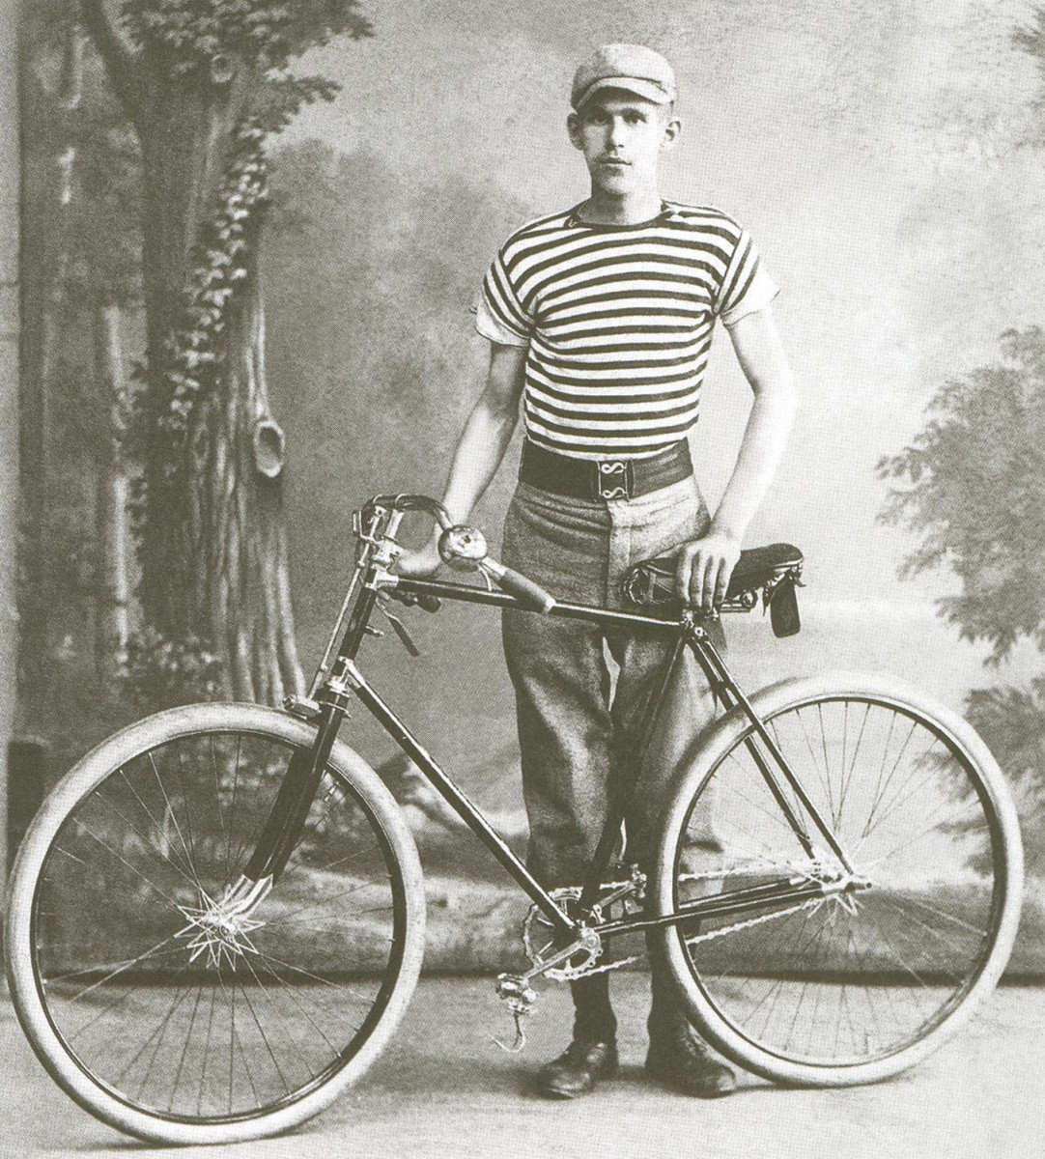
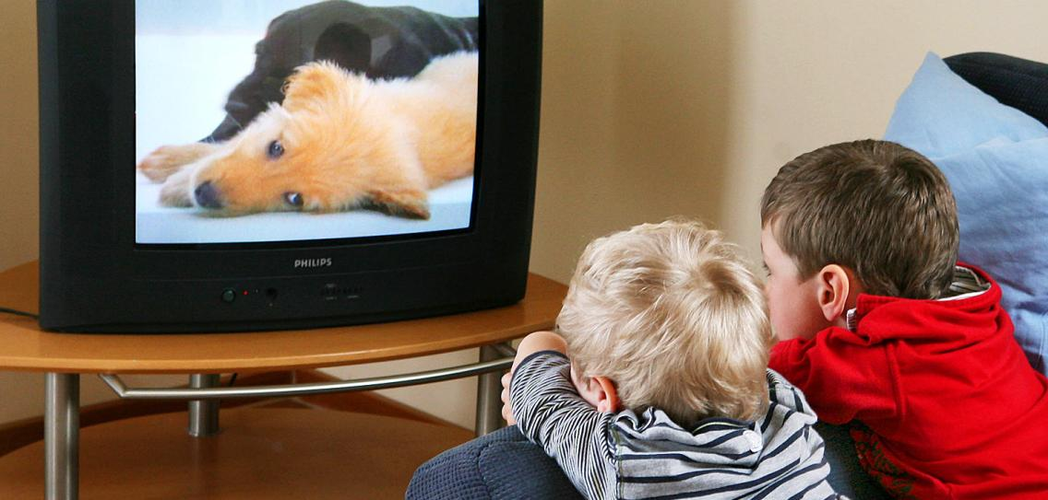

Hobbys
Musik hören
Ich höre Musik. Rad fahren
Ich fahre Rad.
Bücher lesen
Ich lese Bücher.
fernsehen
Ich sehe fern.
© istockphoto
© Wikimedia
© img.welt
© freepik
© GET Across Borders

Slide 6
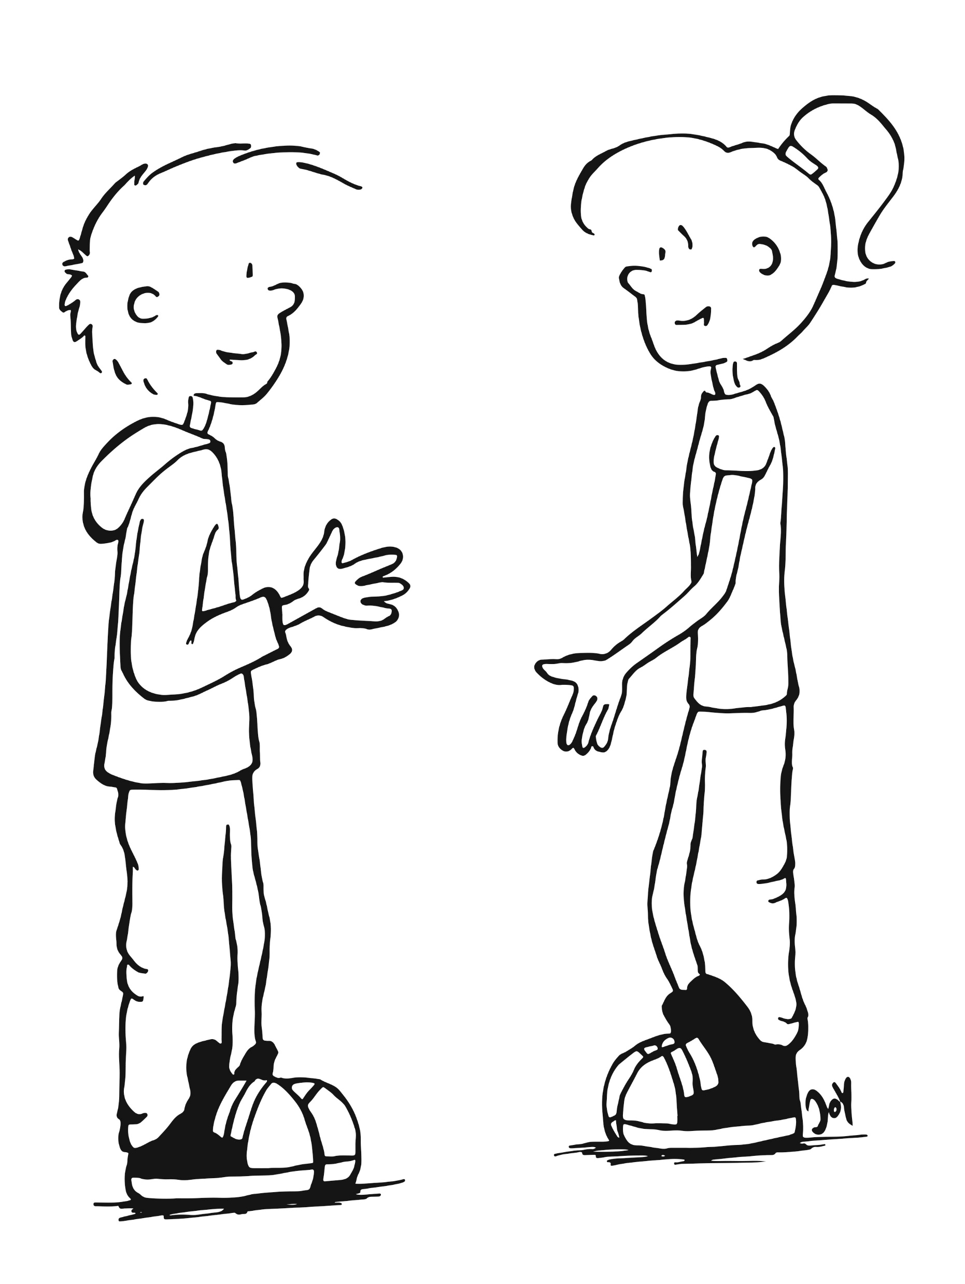
Hobbys
What are your hobbies?
Was sind deine Hobbys?
© GET Across Borders

Slide 7

Hobbys
Ich…
…schwimme gern.
…spiele gern Rugby.
…reite gern.
…höre gern Musik.
…lese gern Bücher.
…schaue gern fern.
…fahre gern Rad.
© GET Across Borders

Slide 8
Partner work
Ask your partner for his or her hobbies and answer the question yourself.
© GET Across Borders

Slide 9
Presentation
Give a short presentation about your hobby to the class.
Include your weekend activities.
Check anything you do not know in the dictionary.
© GET Across Borders

Slide 10
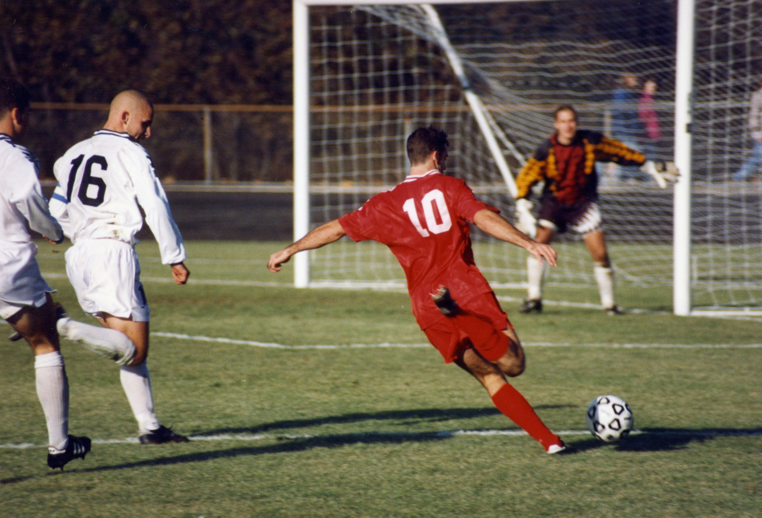
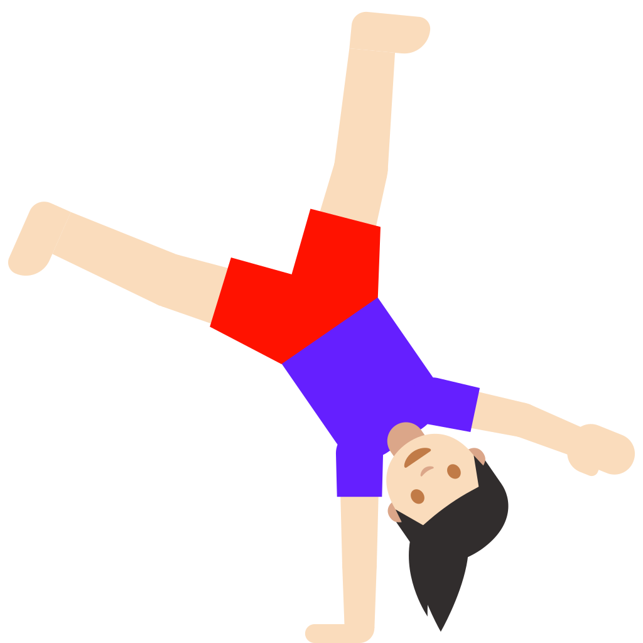
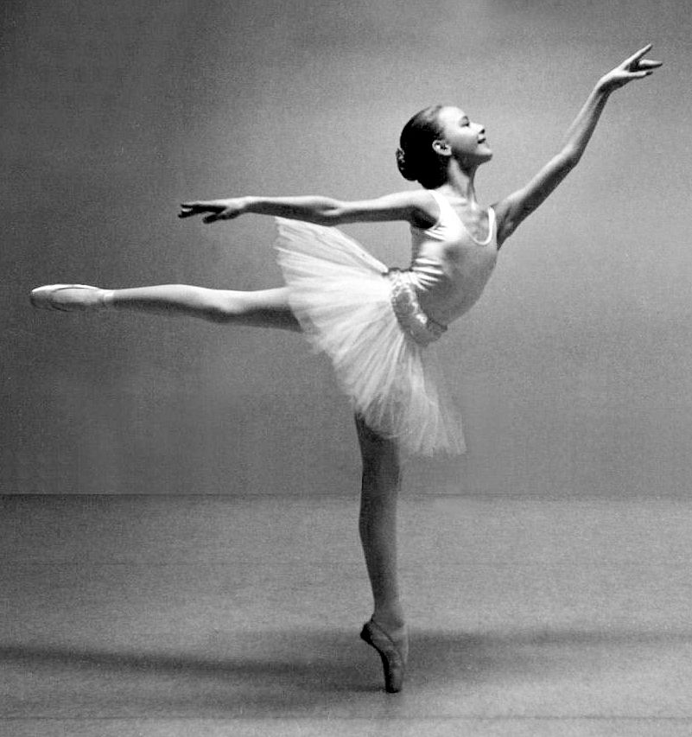
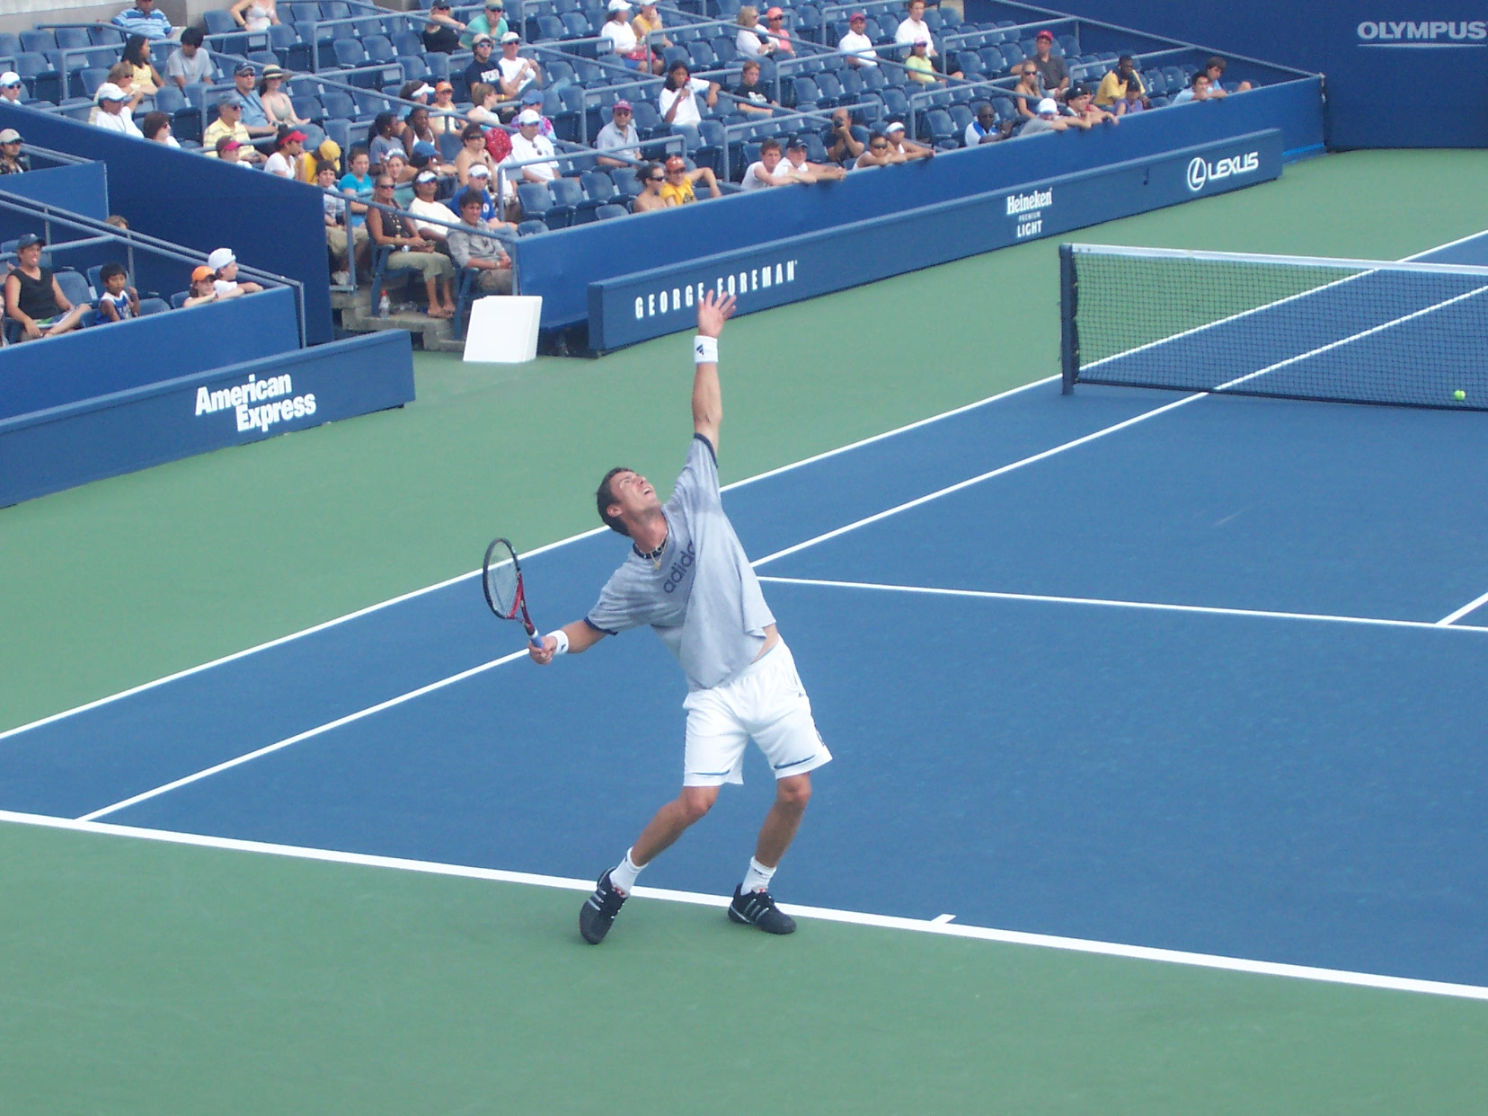
Sports
Fußball spielen Gymnastik
Ich spiele Fußball Ich mache Gymnastik
tanzen
Ich tanze
Tennis spielen
Ich spiele Tennis
© Rdikeman / Wikimedia
© Google / Wikimedia
© Frode Inge Helland / Wikimedia
© Alexisreal / Wikimedia
© GET Across Borders

Slide 11
Pantomime
Pantomime a kind of sport in front of the class. Your classmates have to guess the correct answer. You can also use the sports introduced in the hobby section.
© GET Across Borders
11

Slide 12
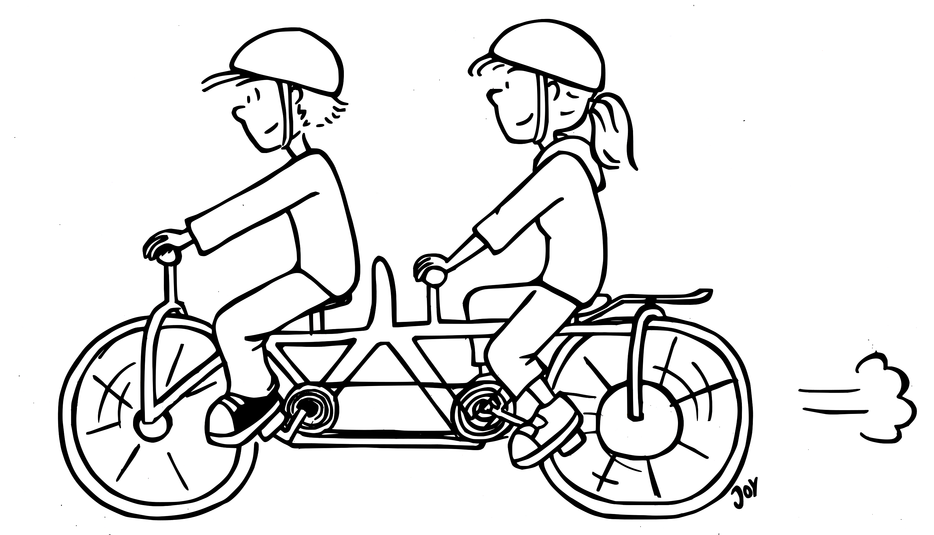
Sports
What sports do you do?
Welchen Sport machst du?
© GET Across Borders

Slide 13
Sport
Ich…
mache gern Gymnastik.
spiele gern Fußball.
spiele gern Rugby.
reite gern.
tanze gern.
spiele gern Tennis.
© GET Across Borders

Slide 14
Presentation
Tell your classmates what kind of sport you do. Also tell your opinion about at least one more sport.
© GET Across Borders
14

Slide 15
Sources
https://commons.wikimedia.org/wiki/File:2017.06.17.16.45.40-Rory_Arnold_charge_down-0002_(35334056076).jpg
https://commons.wikimedia.org/wiki/File:Frog_%C5%BE%C3%A1ba.gif
https://commons.wikimedia.org/wiki/File:Rodeo_in_Panama_02.jpg
https://media.istockphoto.com/vectors/girl-with-headphones-listening-to-music-vector-id473026406?k=6&m=473026406&s=612x612&w=0&h=16MM66S_vEP0L-RcULzIX_9OGQf7Bm0nlPCwo914pso=
https://de.freepik.com/vektoren-premium/kinder-lernen-und-lesen-buecher-zusammen_2870830.htm
© GET Across Borders
15

Slide 16
Sources
https://img.welt.de/img/gesundheit/psychologie/mobile105224403/6331621887-ci23x11-w1136/fernsehen-DW-Wissenschaft-Leipzig-jpg.jpg
https://commons.wikimedia.org/wiki/File:Cyclist-with-bicycle-in-russian-empire.jpg
https://commons.wikimedia.org/wiki/File:Football_iu_1996.jpg
https://commons.wikimedia.org/wiki/File:1991-Silje_Studio_11%C3%A5r_cropped.jpg
https://commons.wikimedia.org/wiki/File:Emoji_u1f938_1f3fb_200d_2640.svg
https://commons.wikimedia.org/wiki/File:Marat_safin_1.jpg
© GET Across Borders
16

Slide 17
Thank you for learning German with us! ☺
DISCLAIMER: Please note that any resources uploaded to this website are purely for educational purposes only. If any of the items, photos or texts uploaded are in infringement of copyright then please do not hesitate to contact us and we will have them removed.
© 2020 – GET Across Borders and © Leap4Joy

