Slide 1



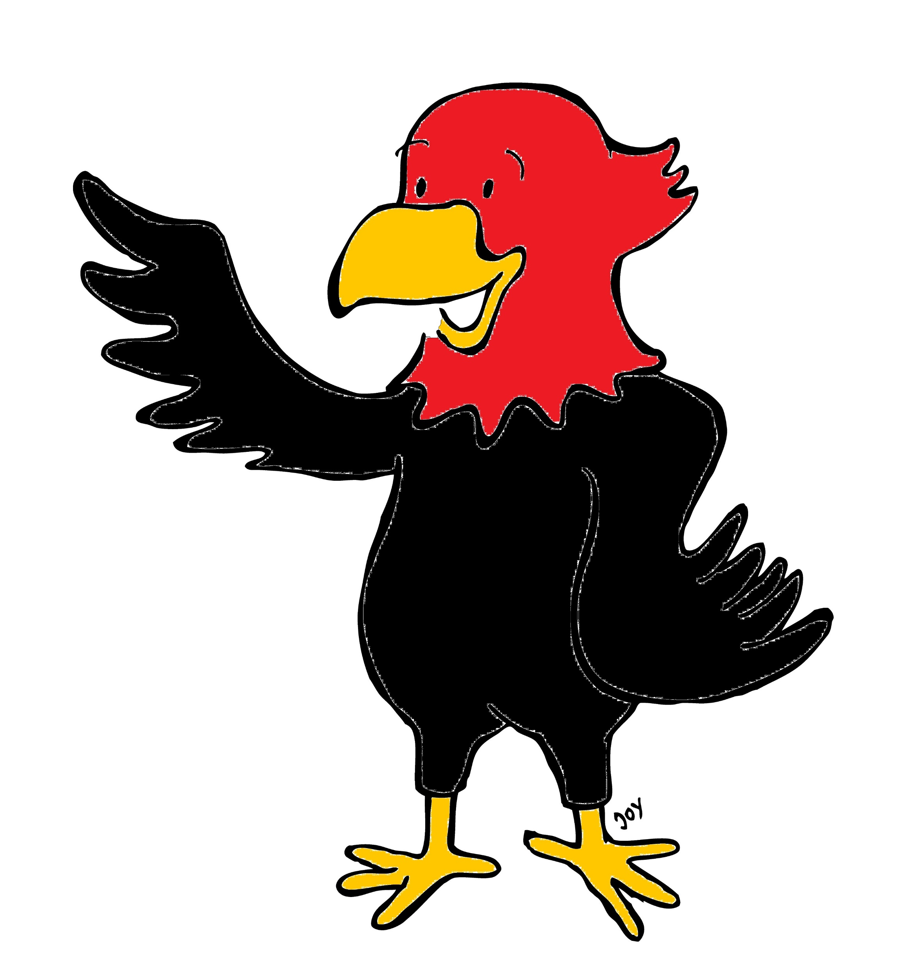

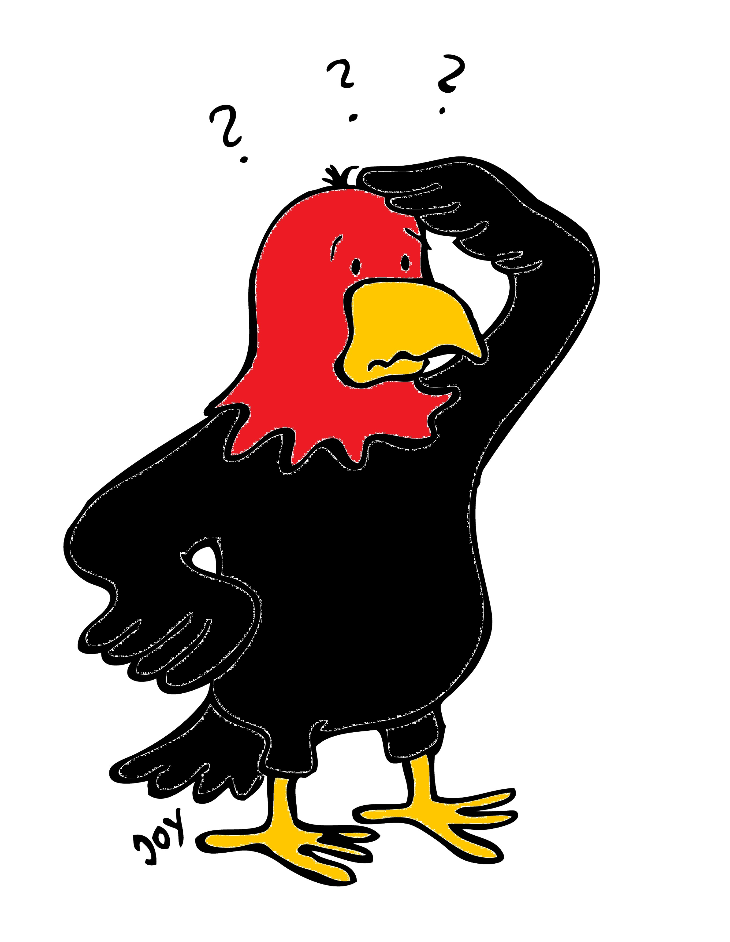
GET Buddied Up
German with Ali, the Eagle
get-across-borders@uni-mainz.de
© 2020 - GET Across Borders

Slide 2
Deutsch lernen mit Ali, unserem Adler
Sigrid Rieuwerts get-across-borders@uni-mainz.de

Slide 3
Willkommen!
Today we are going to learn about…
classroom rituals (Klassenraumrituale).
© GET Across Borders
3

Slide 4

Die Begrüßung
The greeting
This is how you greet each other in German:
„Guten Morgen” – “Good Morning”
or
„Guten Tag” – “Good day”
© GET Across Borders
4

Slide 5
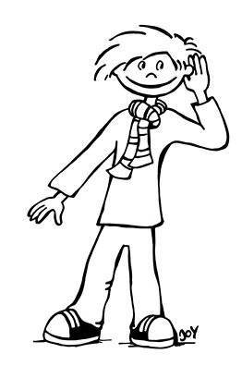
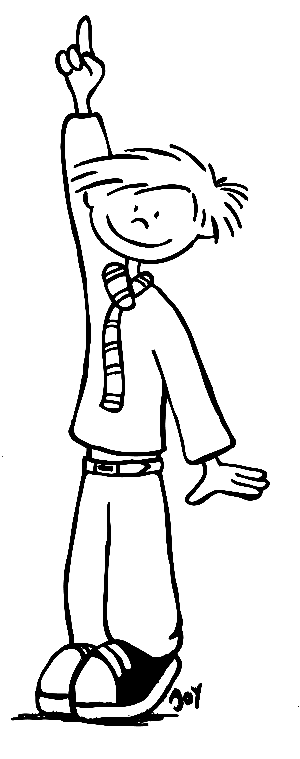
Im Klassenraum
In the classroom
Listen to the other students.
Höre den anderen Schülern zu.
Put up your hand.
Melde dich.
© GET Across Borders
5

Slide 6
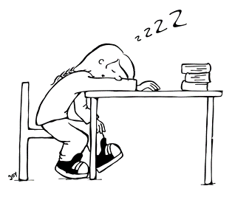
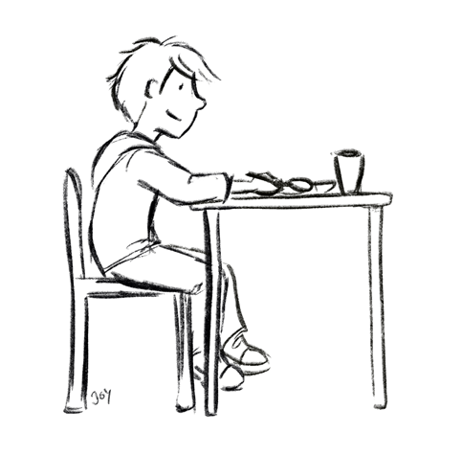
Im Klassenraum
In the classroom
Sei aufmerksam! – Pay attention!
© GET Across Borders
6

Slide 7
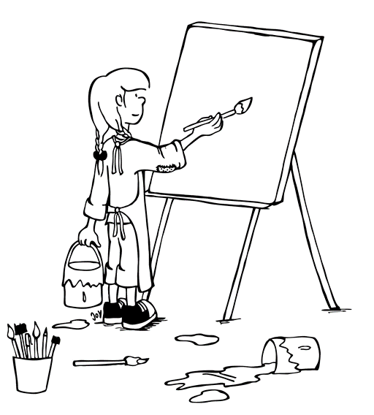
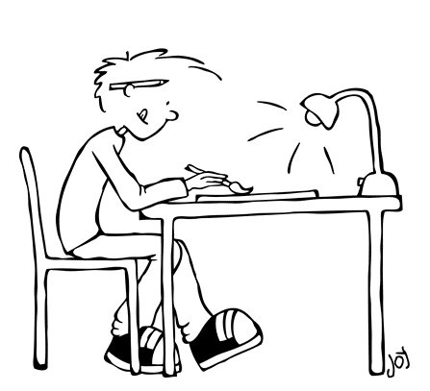
Kunstunterricht
Im Kunstunterricht lernen die Kinder malen.
In art lessons, the children learn how to paint.
© GET Across Borders
7

Slide 8
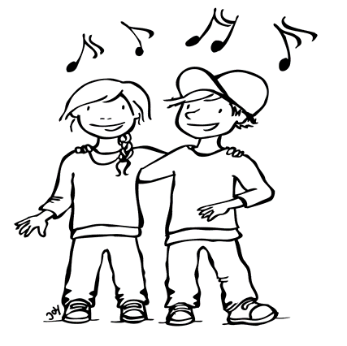
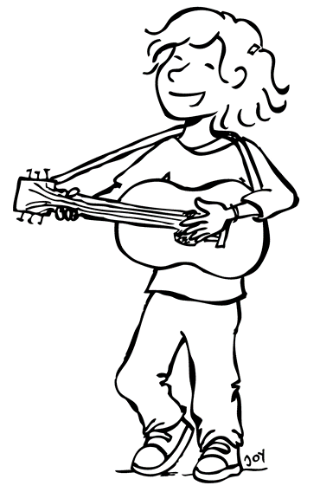
Musik
Die Kinder singen oft
zusammen.
The children often sing together.
© GET Across Borders
8

Slide 9
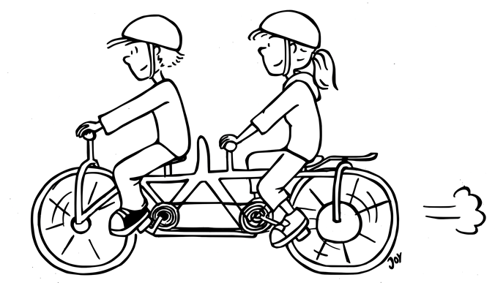
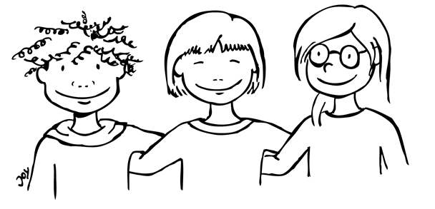
Gemeinsam sind wir stark!
Together we are strong!
Hilf anderen Kindern.
Help other children.
Sei freundlich zu anderen Kindern.
Be kind to other children.
© GET Across Borders
9

Slide 10
Die Verabschiedung
The goodbye
This is how the teacher says goodbye:
„Auf Wiedersehen. Habt noch einen schönen Tag.“
“Goodbye. Have a nice day.”
And the students respond like this:
„Danke gleichfalls. Auf Wiedersehen.“
“Thank you, you too. Goodbye.”
© GET Across Borders
10

Slide 11
Summary
Now you know about some classroom rituals and rules you should follow when you have lessons.
© GET Across Borders
11

Slide 12
Thank you for learning German with us! ☺
DISCLAIMER: Please note that any resources uploaded to this website are purely for educational purposes only. If any of the items, photos or texts uploaded are in infringement of copyright then please do not hesitate to contact us and we will have them removed.
© 2020 – GET Across Borders and © Leap4Joy

