Slide 1



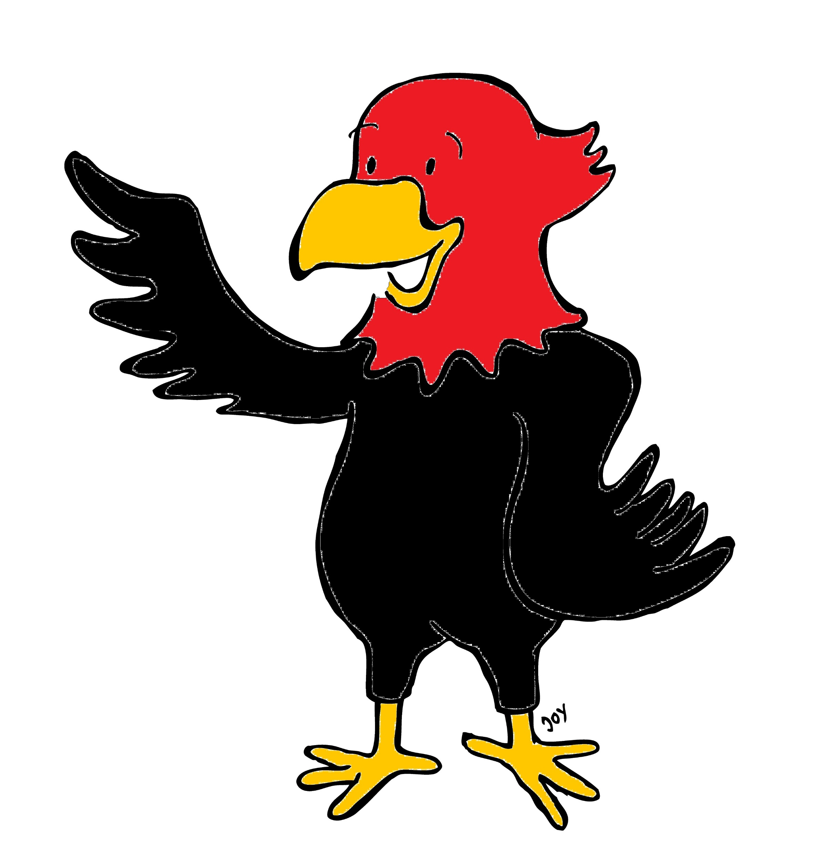

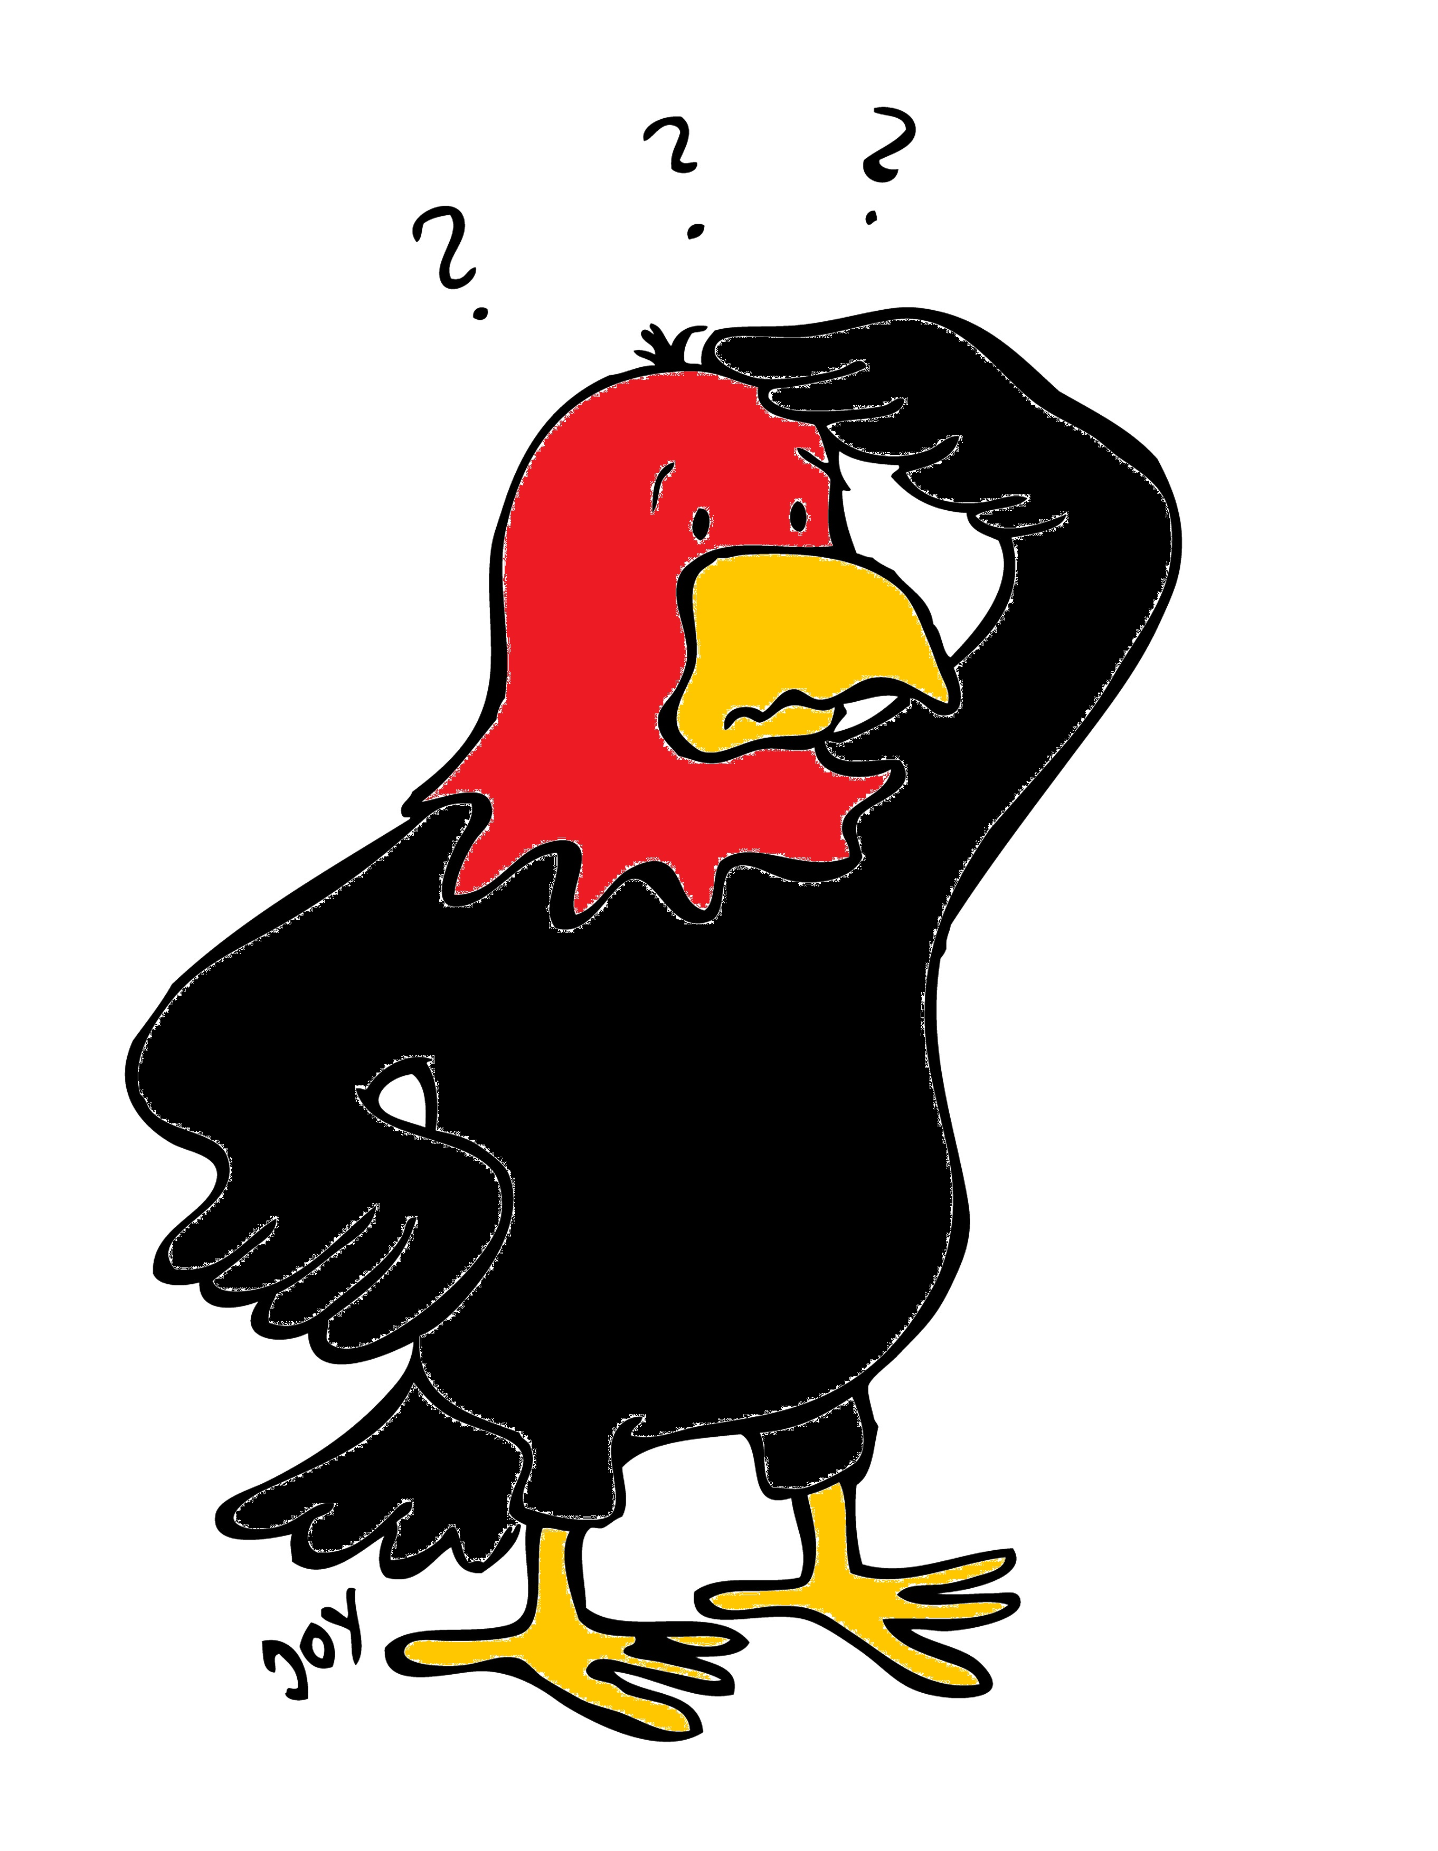
GET Buddied Up
German with Ali, the Eagle
get-across-borders@uni-mainz.de
© 2020 - GET Across Borders

Slide 2
Deutsch lernen mit Ali, unserem Adler
Sigrid Rieuwerts get-across-borders@uni-mainz.de

Slide 3

Willkommen!
Today we are going to learn…
how to wish someone a happy birthday in German.
how Germans celebrate their birthday.
some birthday games.
some German words for presents.
a German Birthday song.
© GET Across Borders
3

Slide 4

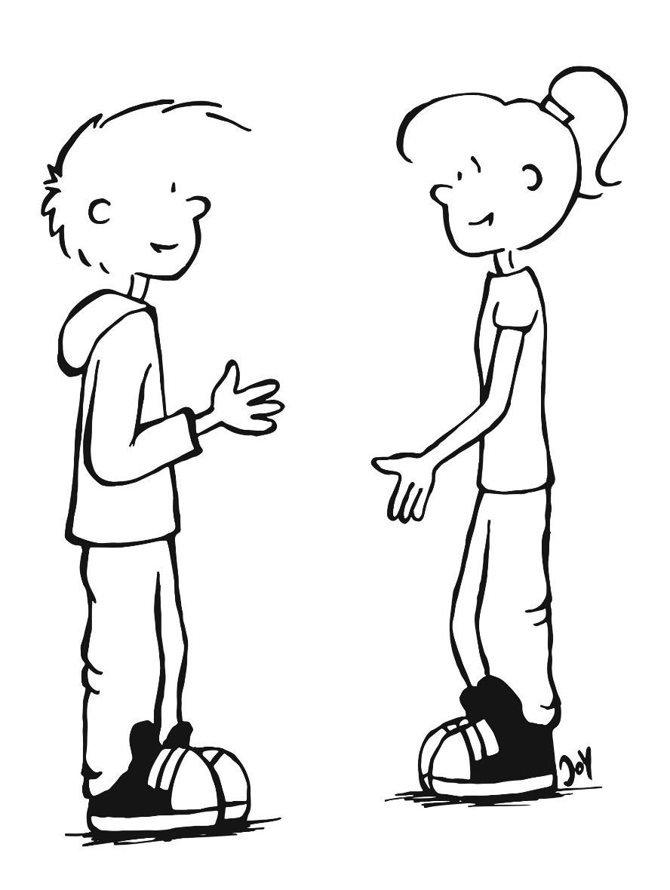
It is Bärbel’s birthday today!
Alles Gute zum Geburtstag!
Danke!
(Thanks!)
© GET Across Borders
4

Slide 5
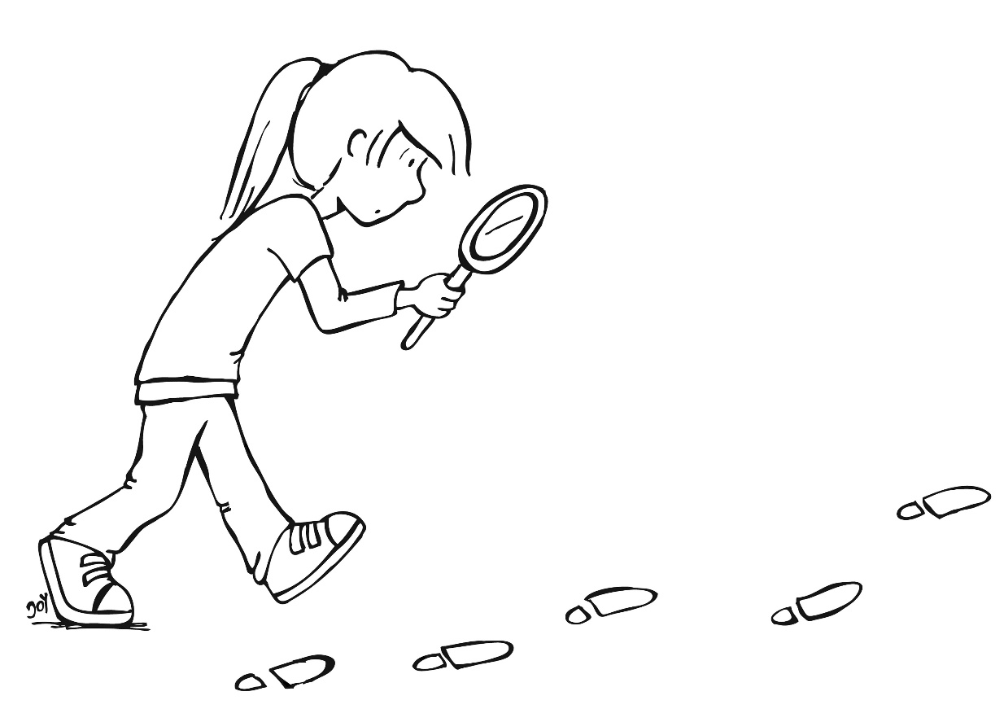
Let’s have a closer look…
Alles Gute zum Geburtstag!
All the best for (your) birthday!
© GET Across Borders
5

Slide 6


What else do children do on their birthday?
Spiele spielen (play games)
Kuchen essen (eat cake)
Geschenke öffnen (open presents)
ein Geburtstagslied singen (sing a birthday song)
© GET Across Borders
6

Slide 7
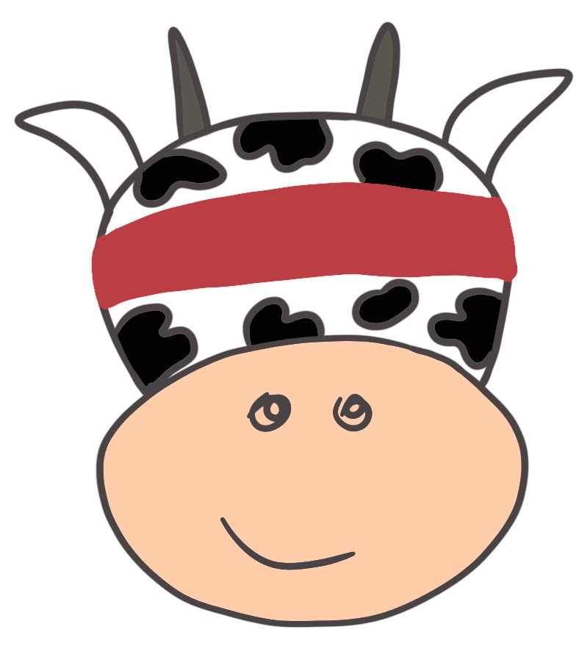
Birthday Games 1
Blinde Kuh
One child is the “blinde Kuh” (blind cow).
He/she is blindfolded and has to catch the other children.
© GET Across Borders
7

Slide 8
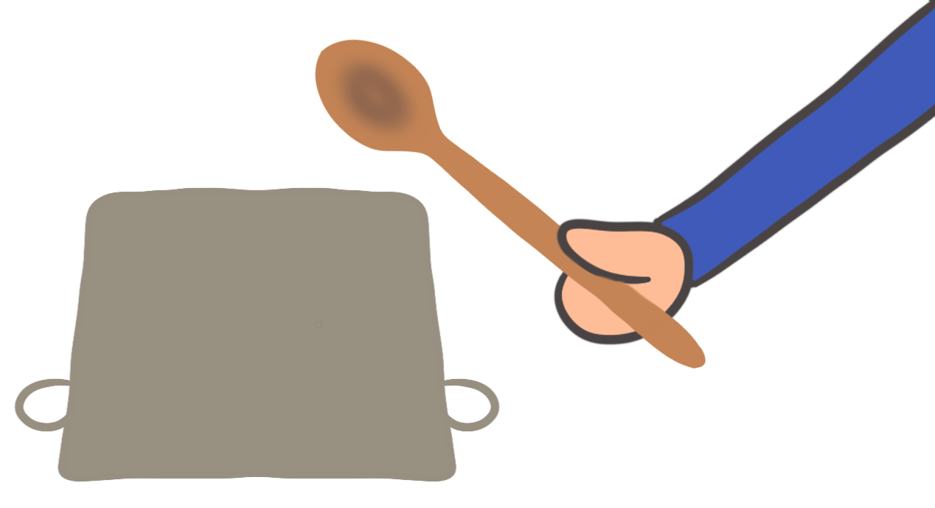
Birthday Games 2
Topfschlagen
(Topf-pot + schlagen-hit)
One child is blindfolded and has to find a pot at the floor with the help of a wooden spoon. There is a sweet treat under the pot!
The other children give hints by saying:
“Heiß!” (Hot!)
  or “Kalt!” (Cold!)
© GET Across Borders
8

Slide 9
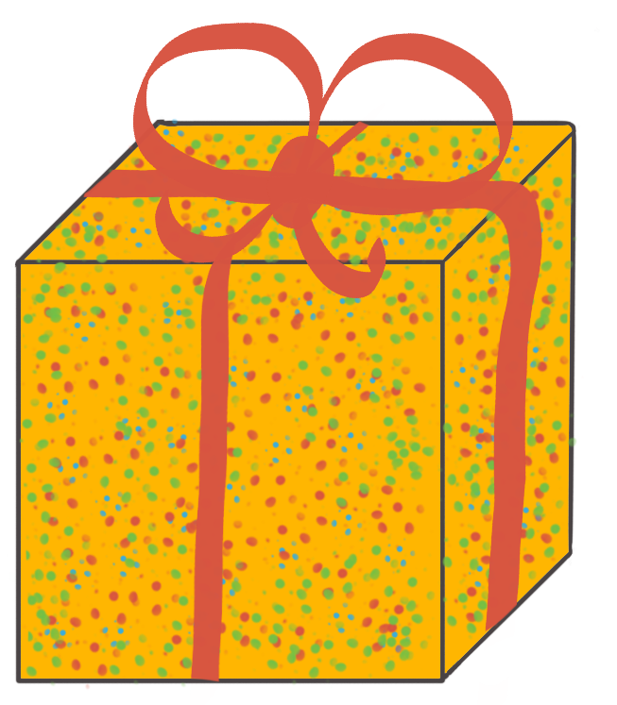
Present 1
Geschenk (present)
Schleife (ribbon)
Geschenkpapier (wrapping paper)
© GET Across Borders
9

Slide 10
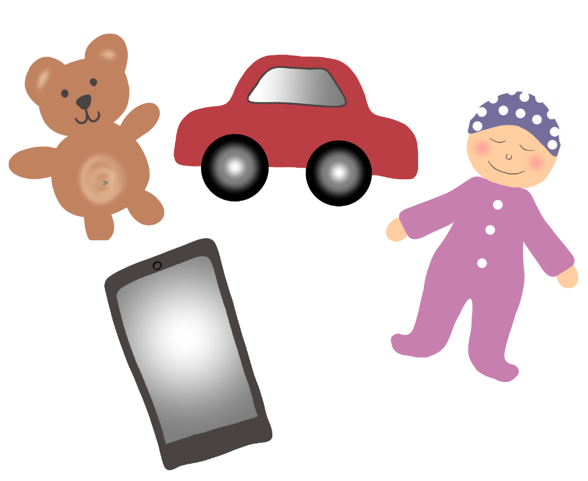
Present 2
Spielzeug (toy)
  Auto (car)
  Puppe (doll)
  Handy (mobile phone)
  Teddybär (teddy bear)
© GET Across Borders
10

Slide 11

Present 3
Blumenstrauß (bunch of flowers)
© GET Across Borders
11

Slide 12

A German birthday song
Zum Geburtstag viel Glück,
zum Geburtstag viel Glück,
zum Geburtstag liebe Bärbel,
zum Geburtstag viel Glück!
© GET Across Borders
12
Notes:
Please click on the sound symbol to play the song.
English lyrics:
Good luck for your birthday,
Good luck for your birthday,
Good luck for your birthday, dear Bärbel,
Good luck for your birthday!

Slide 13
Thank you for learning German with us! ☺
DISCLAIMER: Please note that any resources uploaded to this website are purely for educational purposes only. If any of the items, photos or texts uploaded are in infringement of copyright then please do not hesitate to contact us and we will have them removed.
© 2020 – GET Across Borders and © Leap4Joy

