Slide 1
Time travelling in Scotland’s song
Dr Sally LK Garden
Mons Graupius (Scotland)

Slide 2
Scotland’s song literature
1500s
Oral tradition
Songs listed in Complaynt of Scotland (1548)
1600s
Oral tradition + Manuscripts
MS books for lute etc, with Scots songs a major feature e.g. Skene ms (c1620)
1700s
Oral tradition + Manuscripts + Print
1720s first printed collections of ‘Scots songs’
Scots Musical Museum 6vols
1800s
Antiquarian & historical collections
Popular editions for singing
Emergence of Scottish art song
1900s
Popular editions for singing
Development of Scottish art song

Slide 3
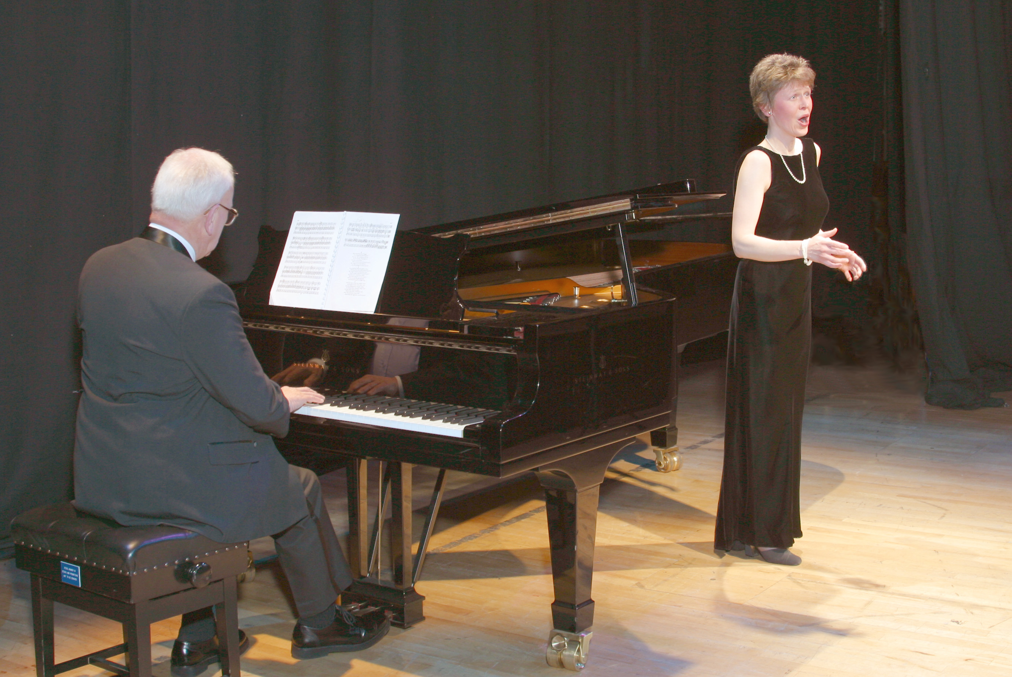
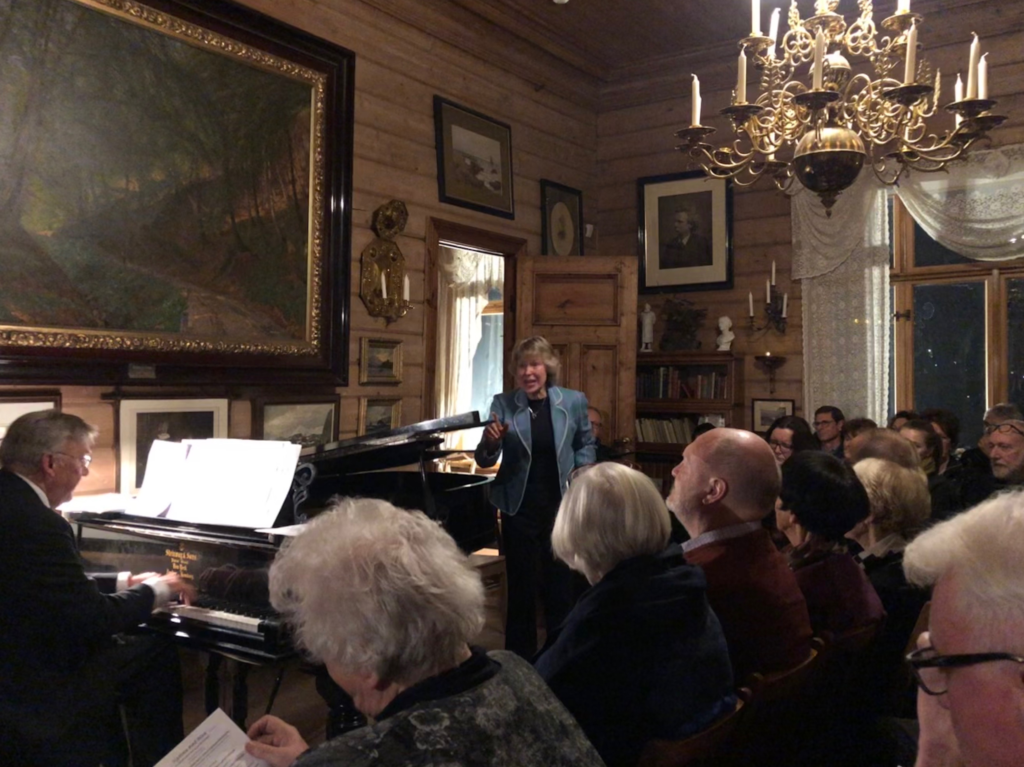
Musical time machine!

Slide 4
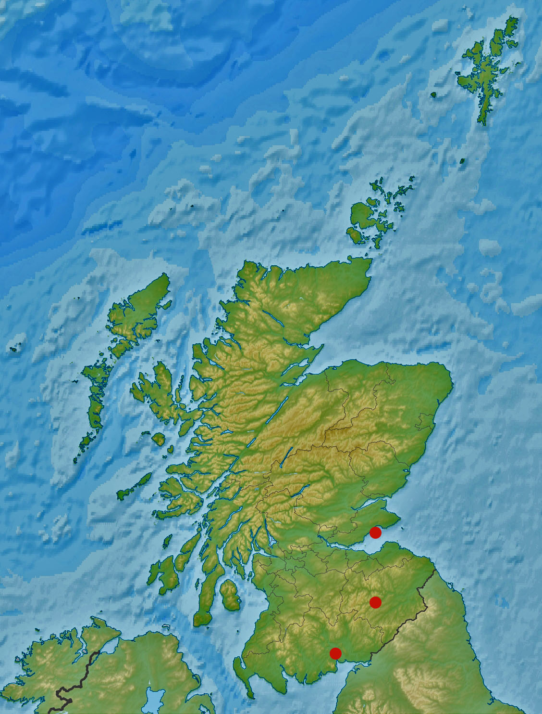
Musical time machine!
3 Scots songs
Late C18
Early C19
Mid C20

Slide 5
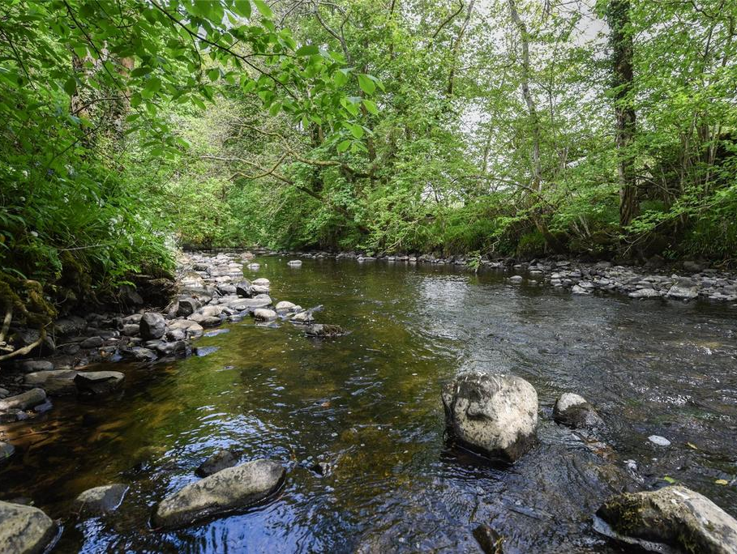
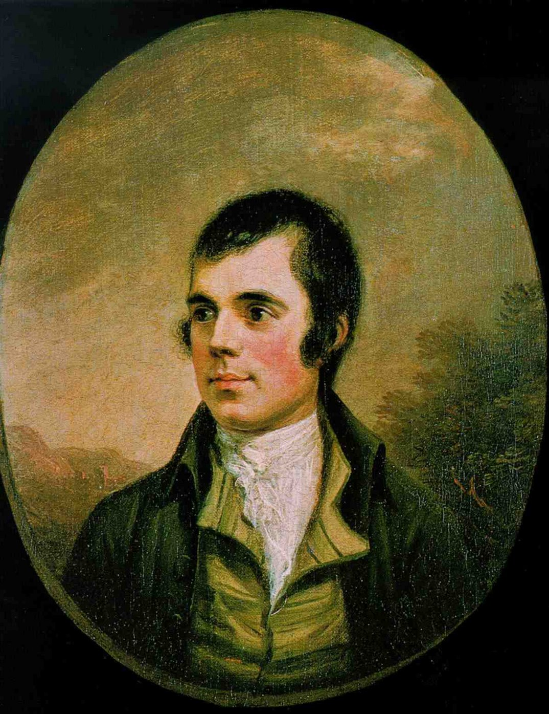
Ca’ the yowes to the knowes
Ca’ the yowes to the knowes,
Ca’ them whare the heather growes
Ca’ them whare the burnie rowes,
My bonnie dearie.
Hark! The mavis’ evening sang,
Sounding Cluden’s woods amang!
Then a-fauldin let us gang,
My bonnie dearie.
Robert Burns
Cluden Water, Kirkcudbrightshire

Slide 6
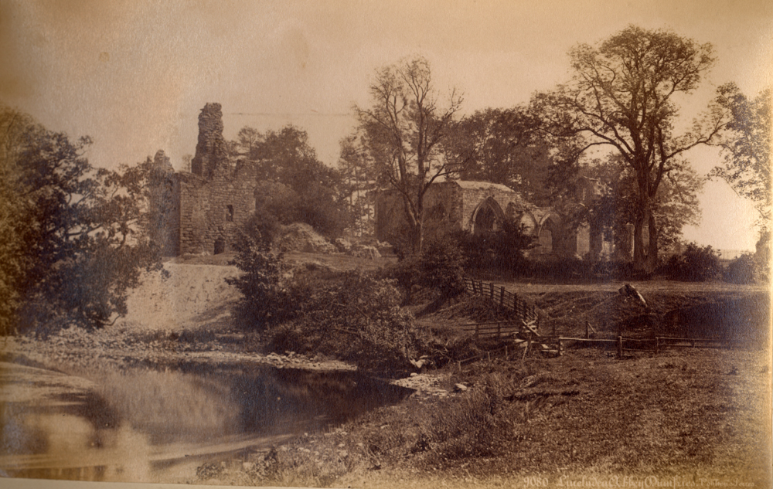
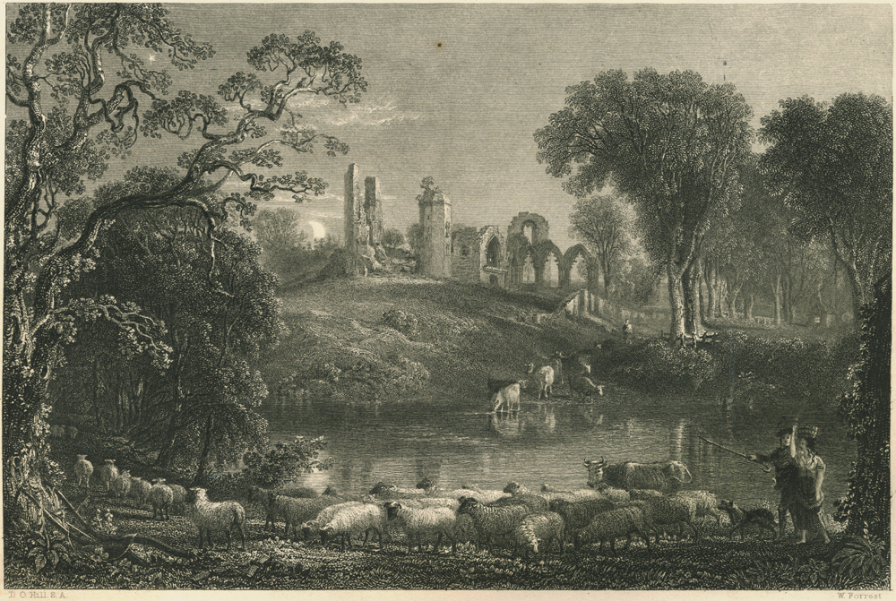
Ca’ the yowes to the knowes

Slide 7
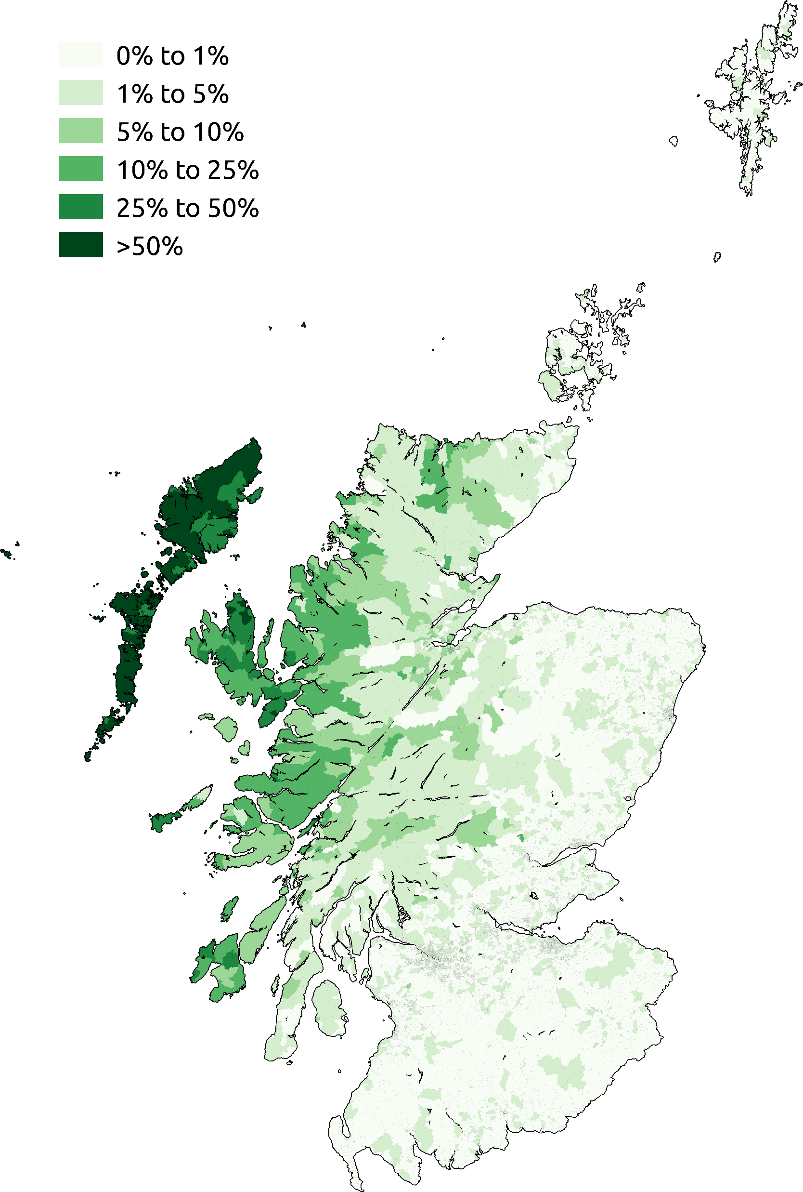
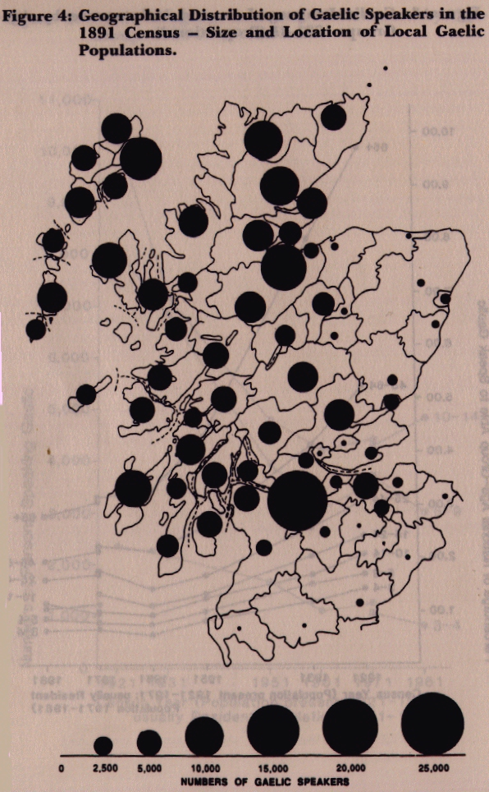
Ca’ the yowes to the knowes

Slide 8
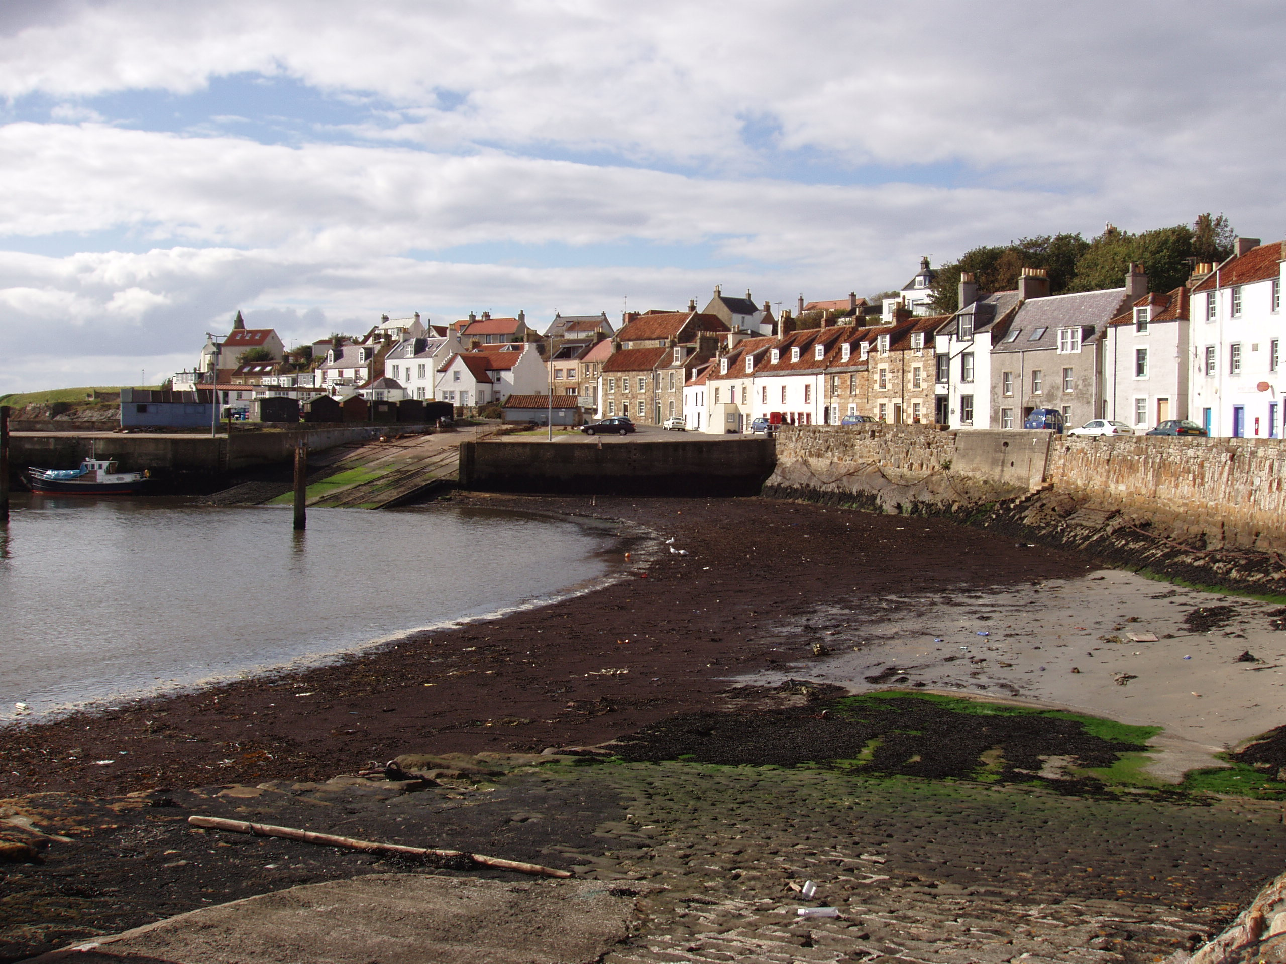
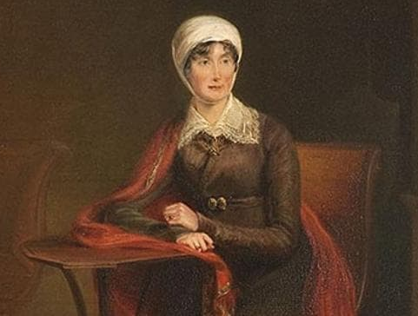
The boatie rows
Joanna Baillie
Largo, Fife

Slide 9
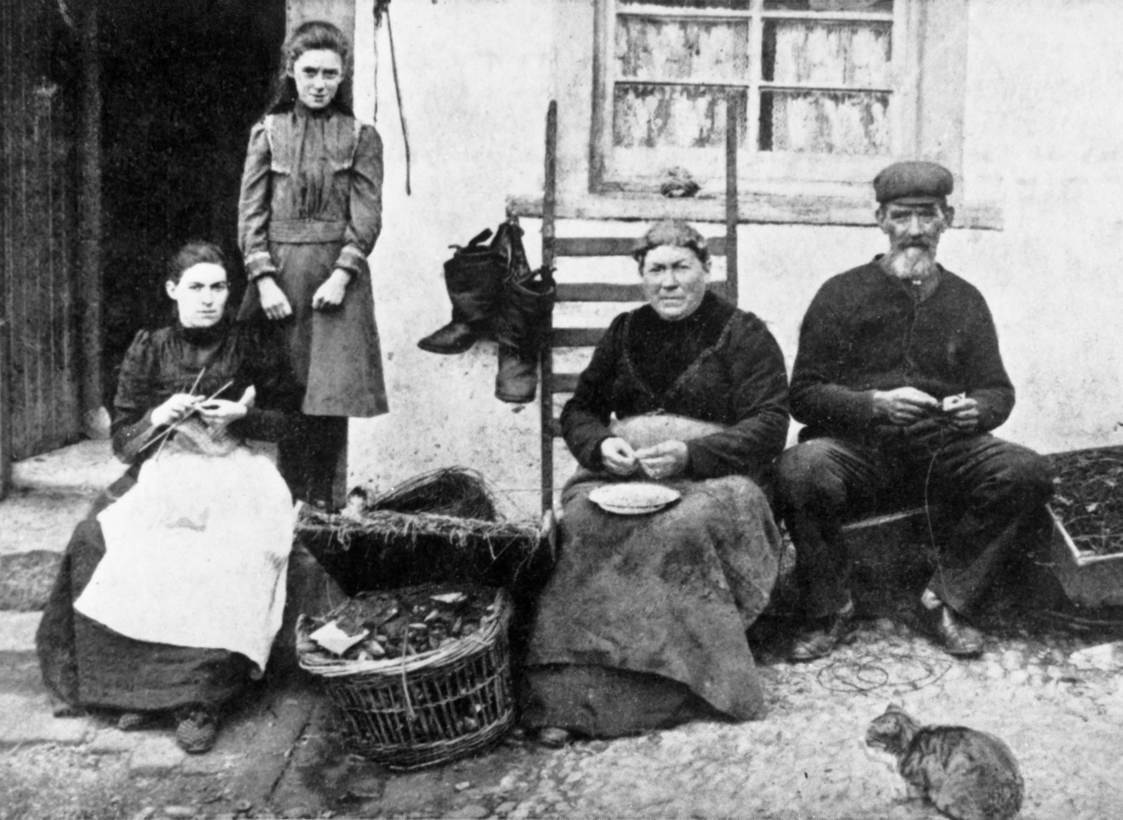
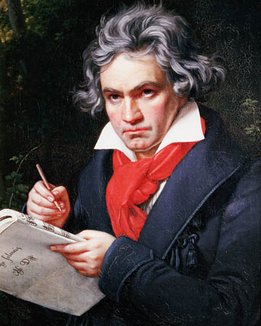
The boatie rows

Slide 10
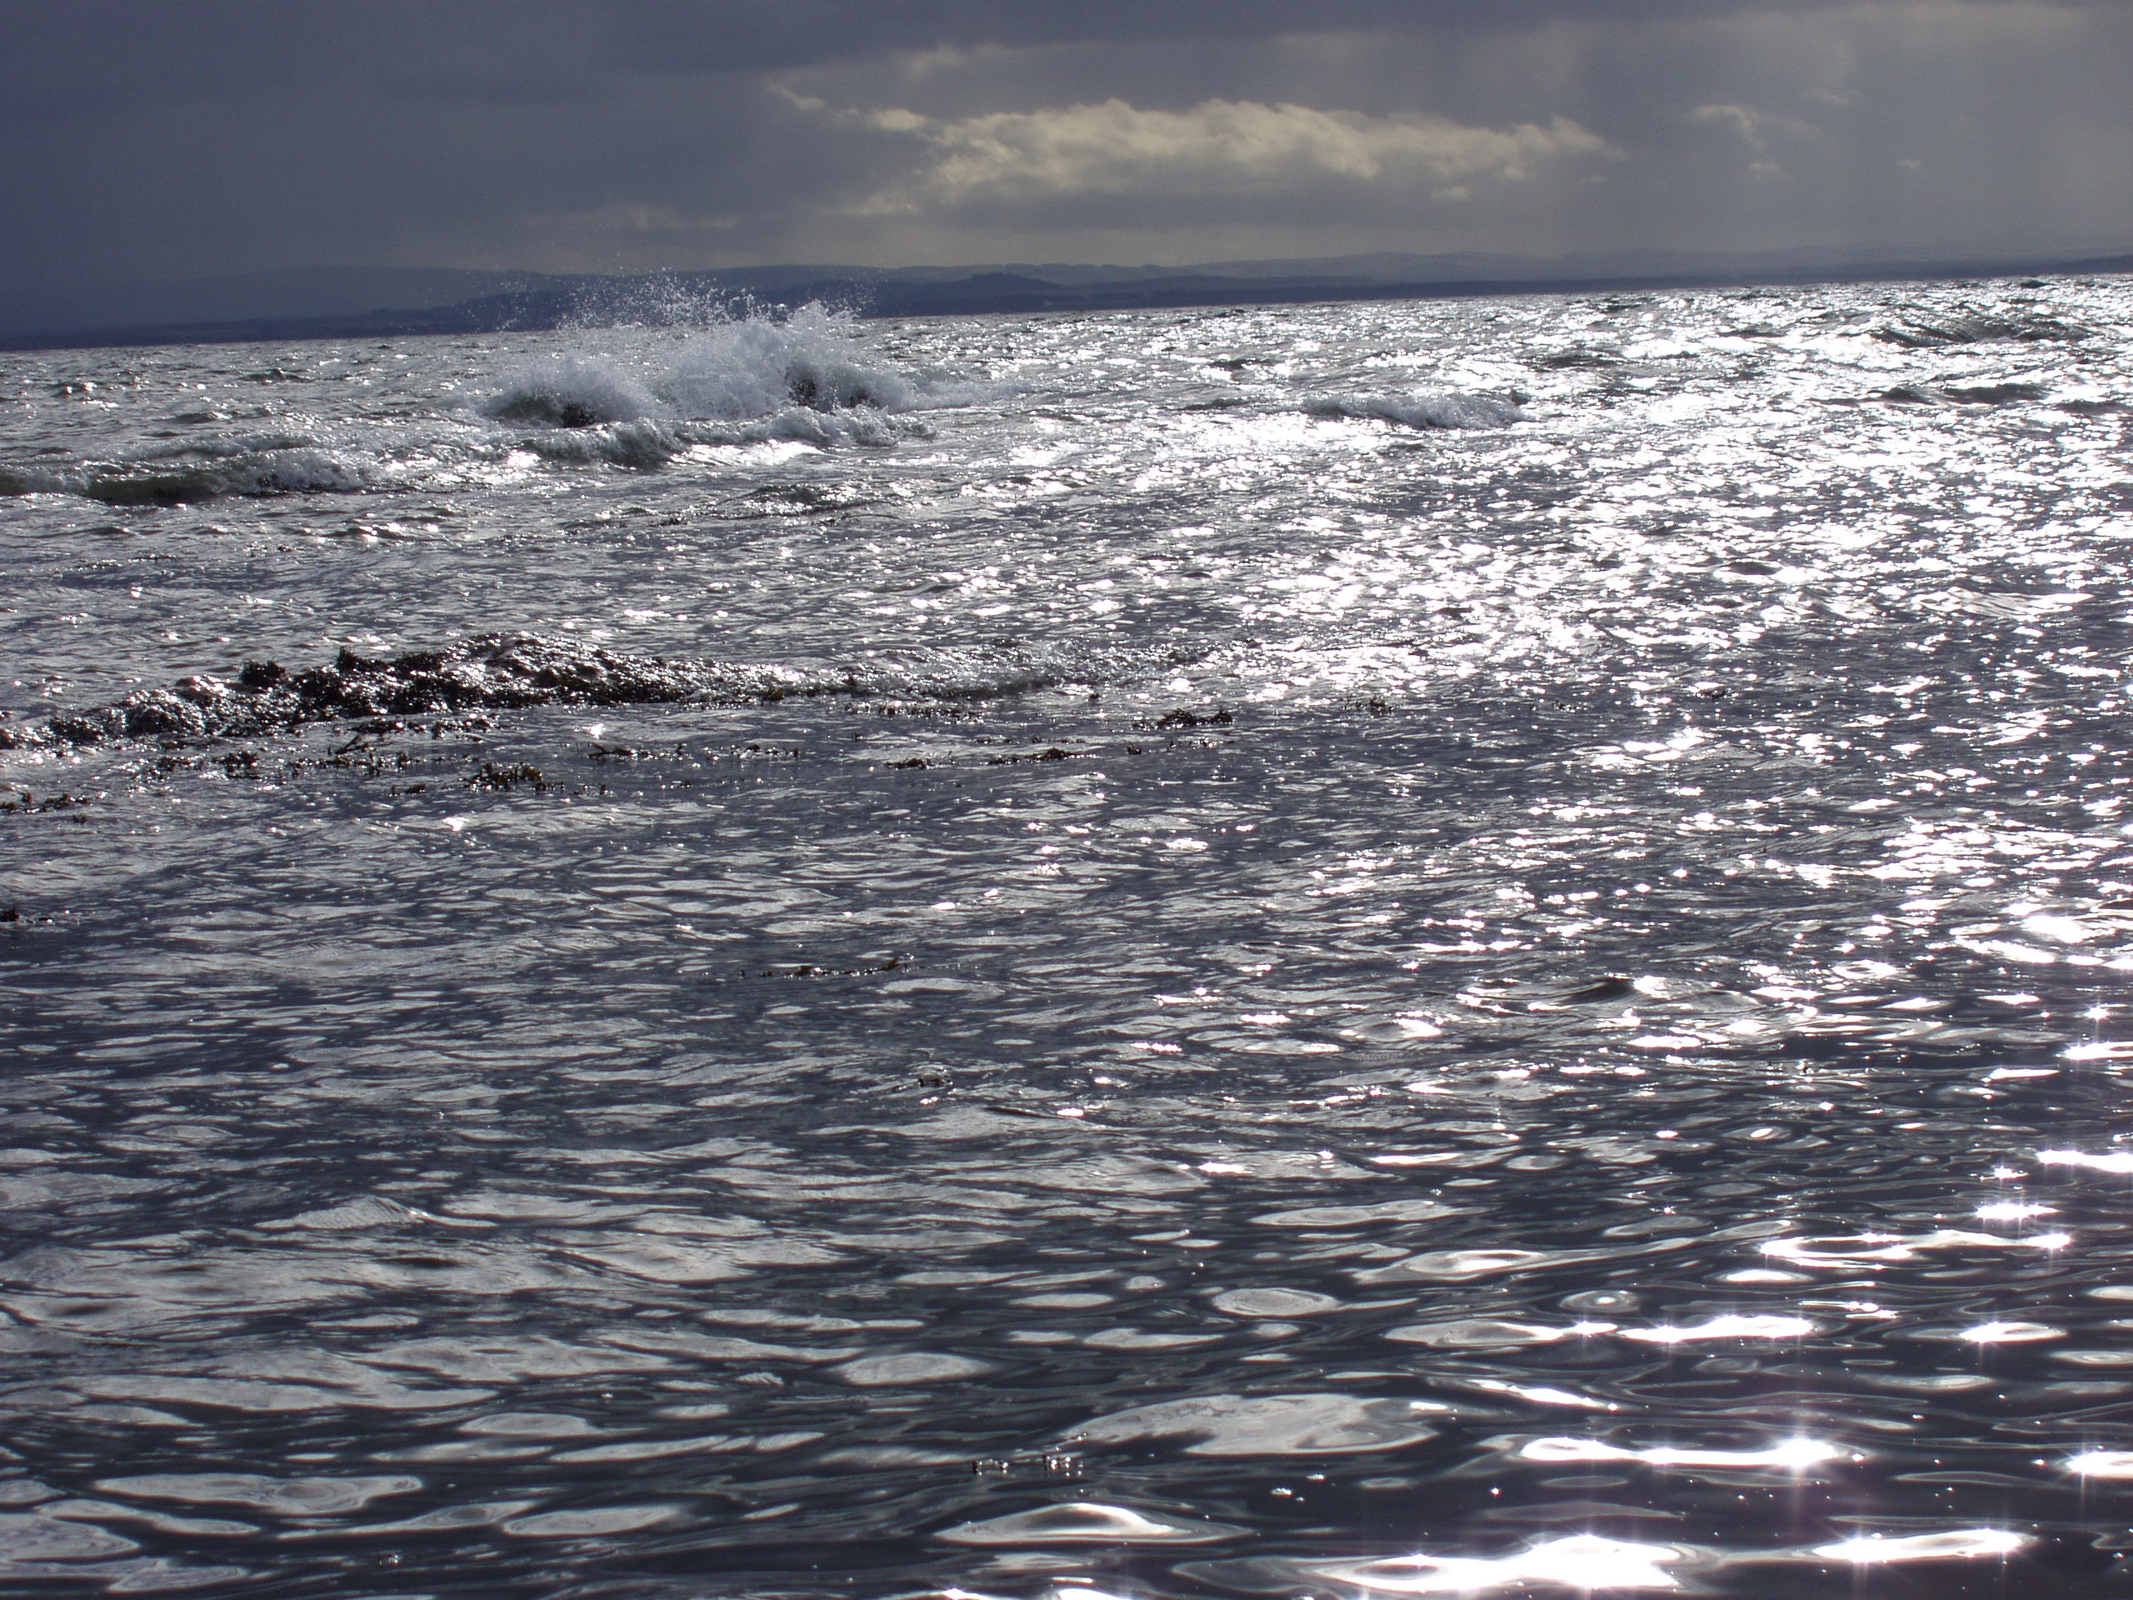
Ettrick
The boatie rows

Slide 11
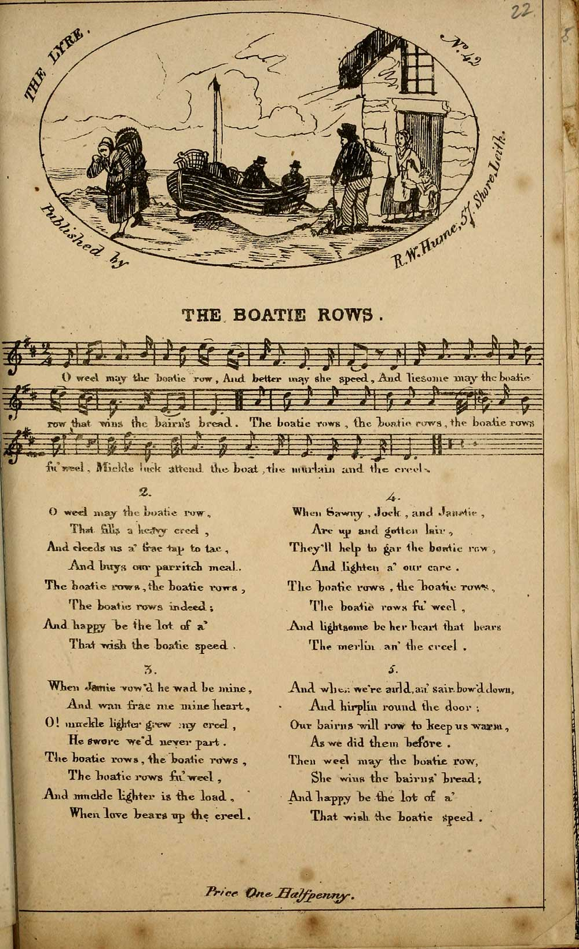
The boatie rows

Slide 12
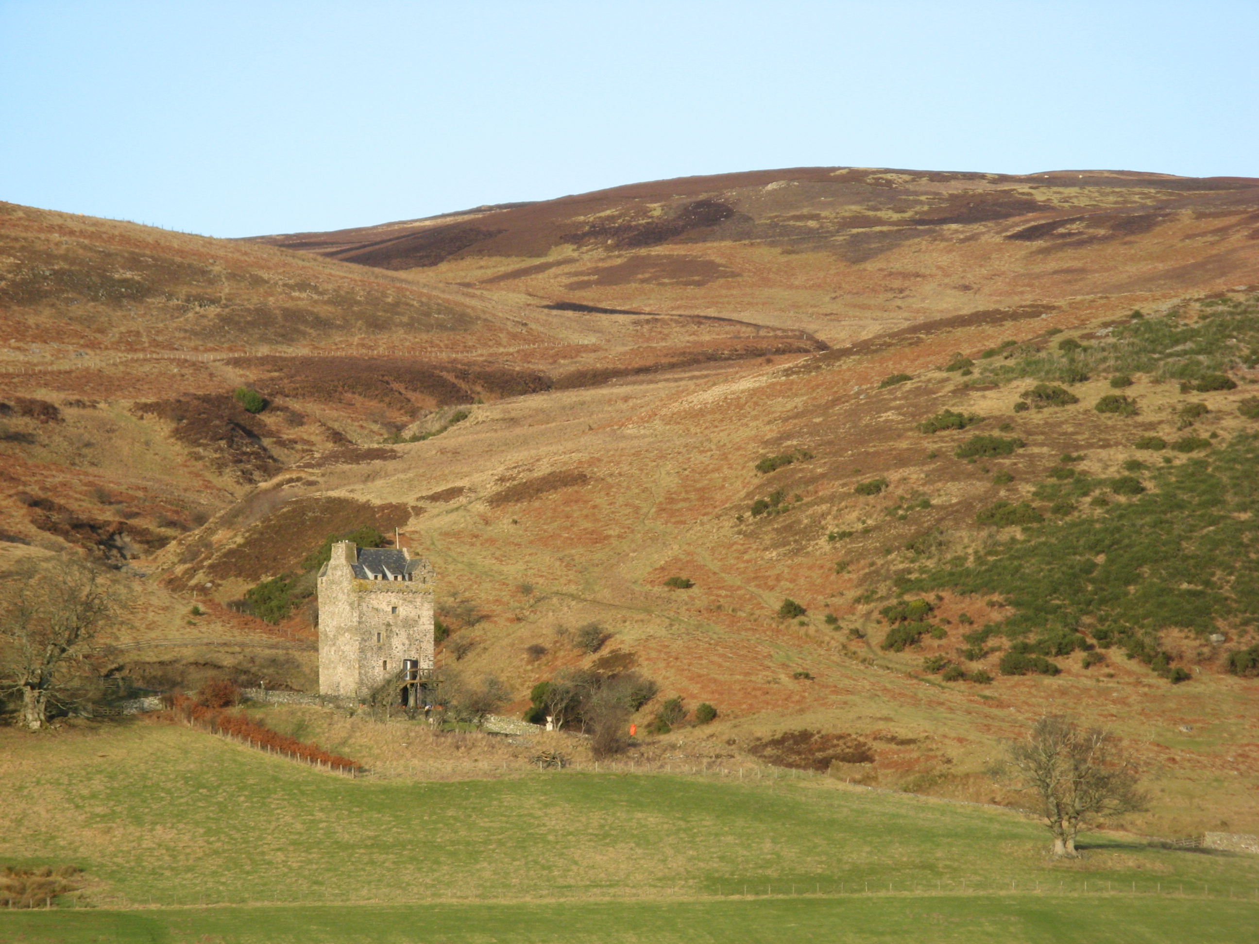
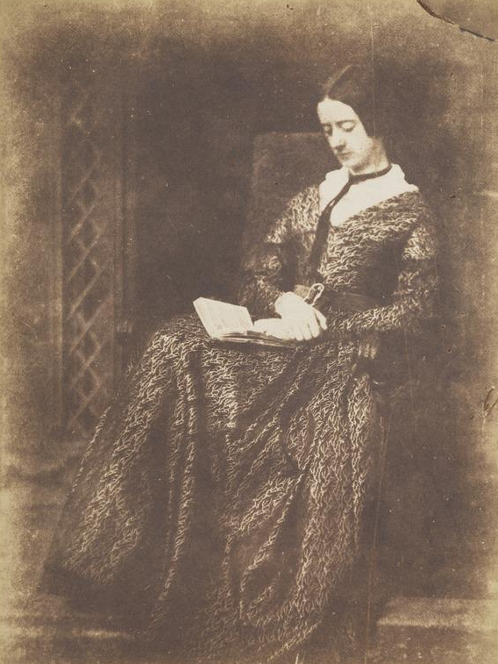
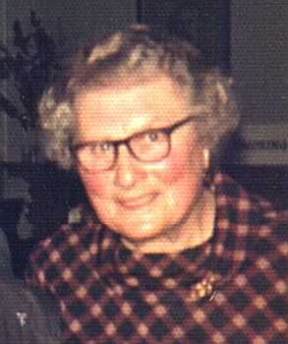
Ettrick
Alicia Anne Spottiswoode (Lady John Scott)
Marie Dare
Ettrick, Selkirkshire

Slide 13
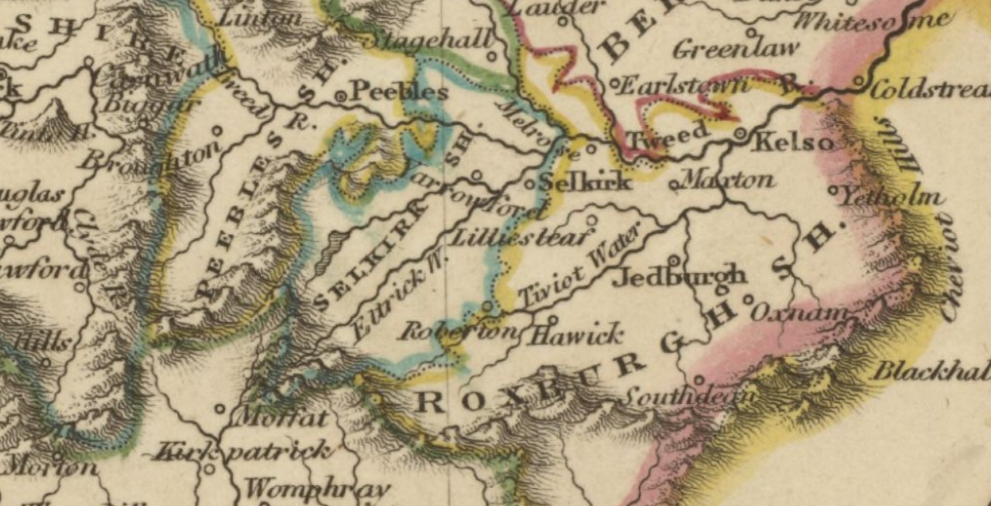
Ettrick

Slide 14
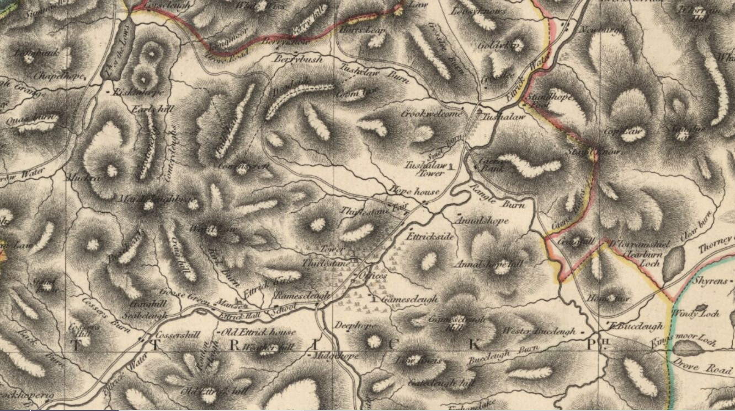
Ettrick

Slide 15
Ettrick

Slide 16
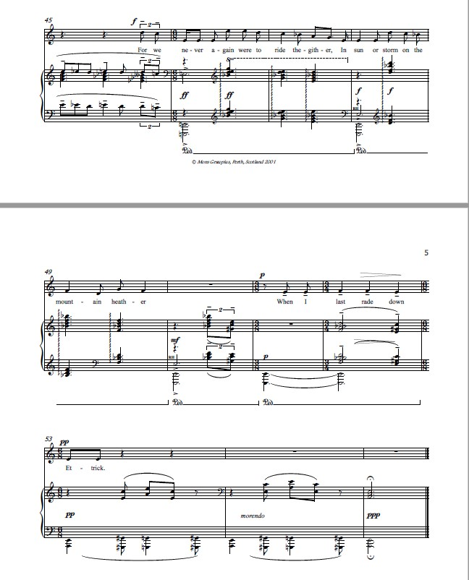
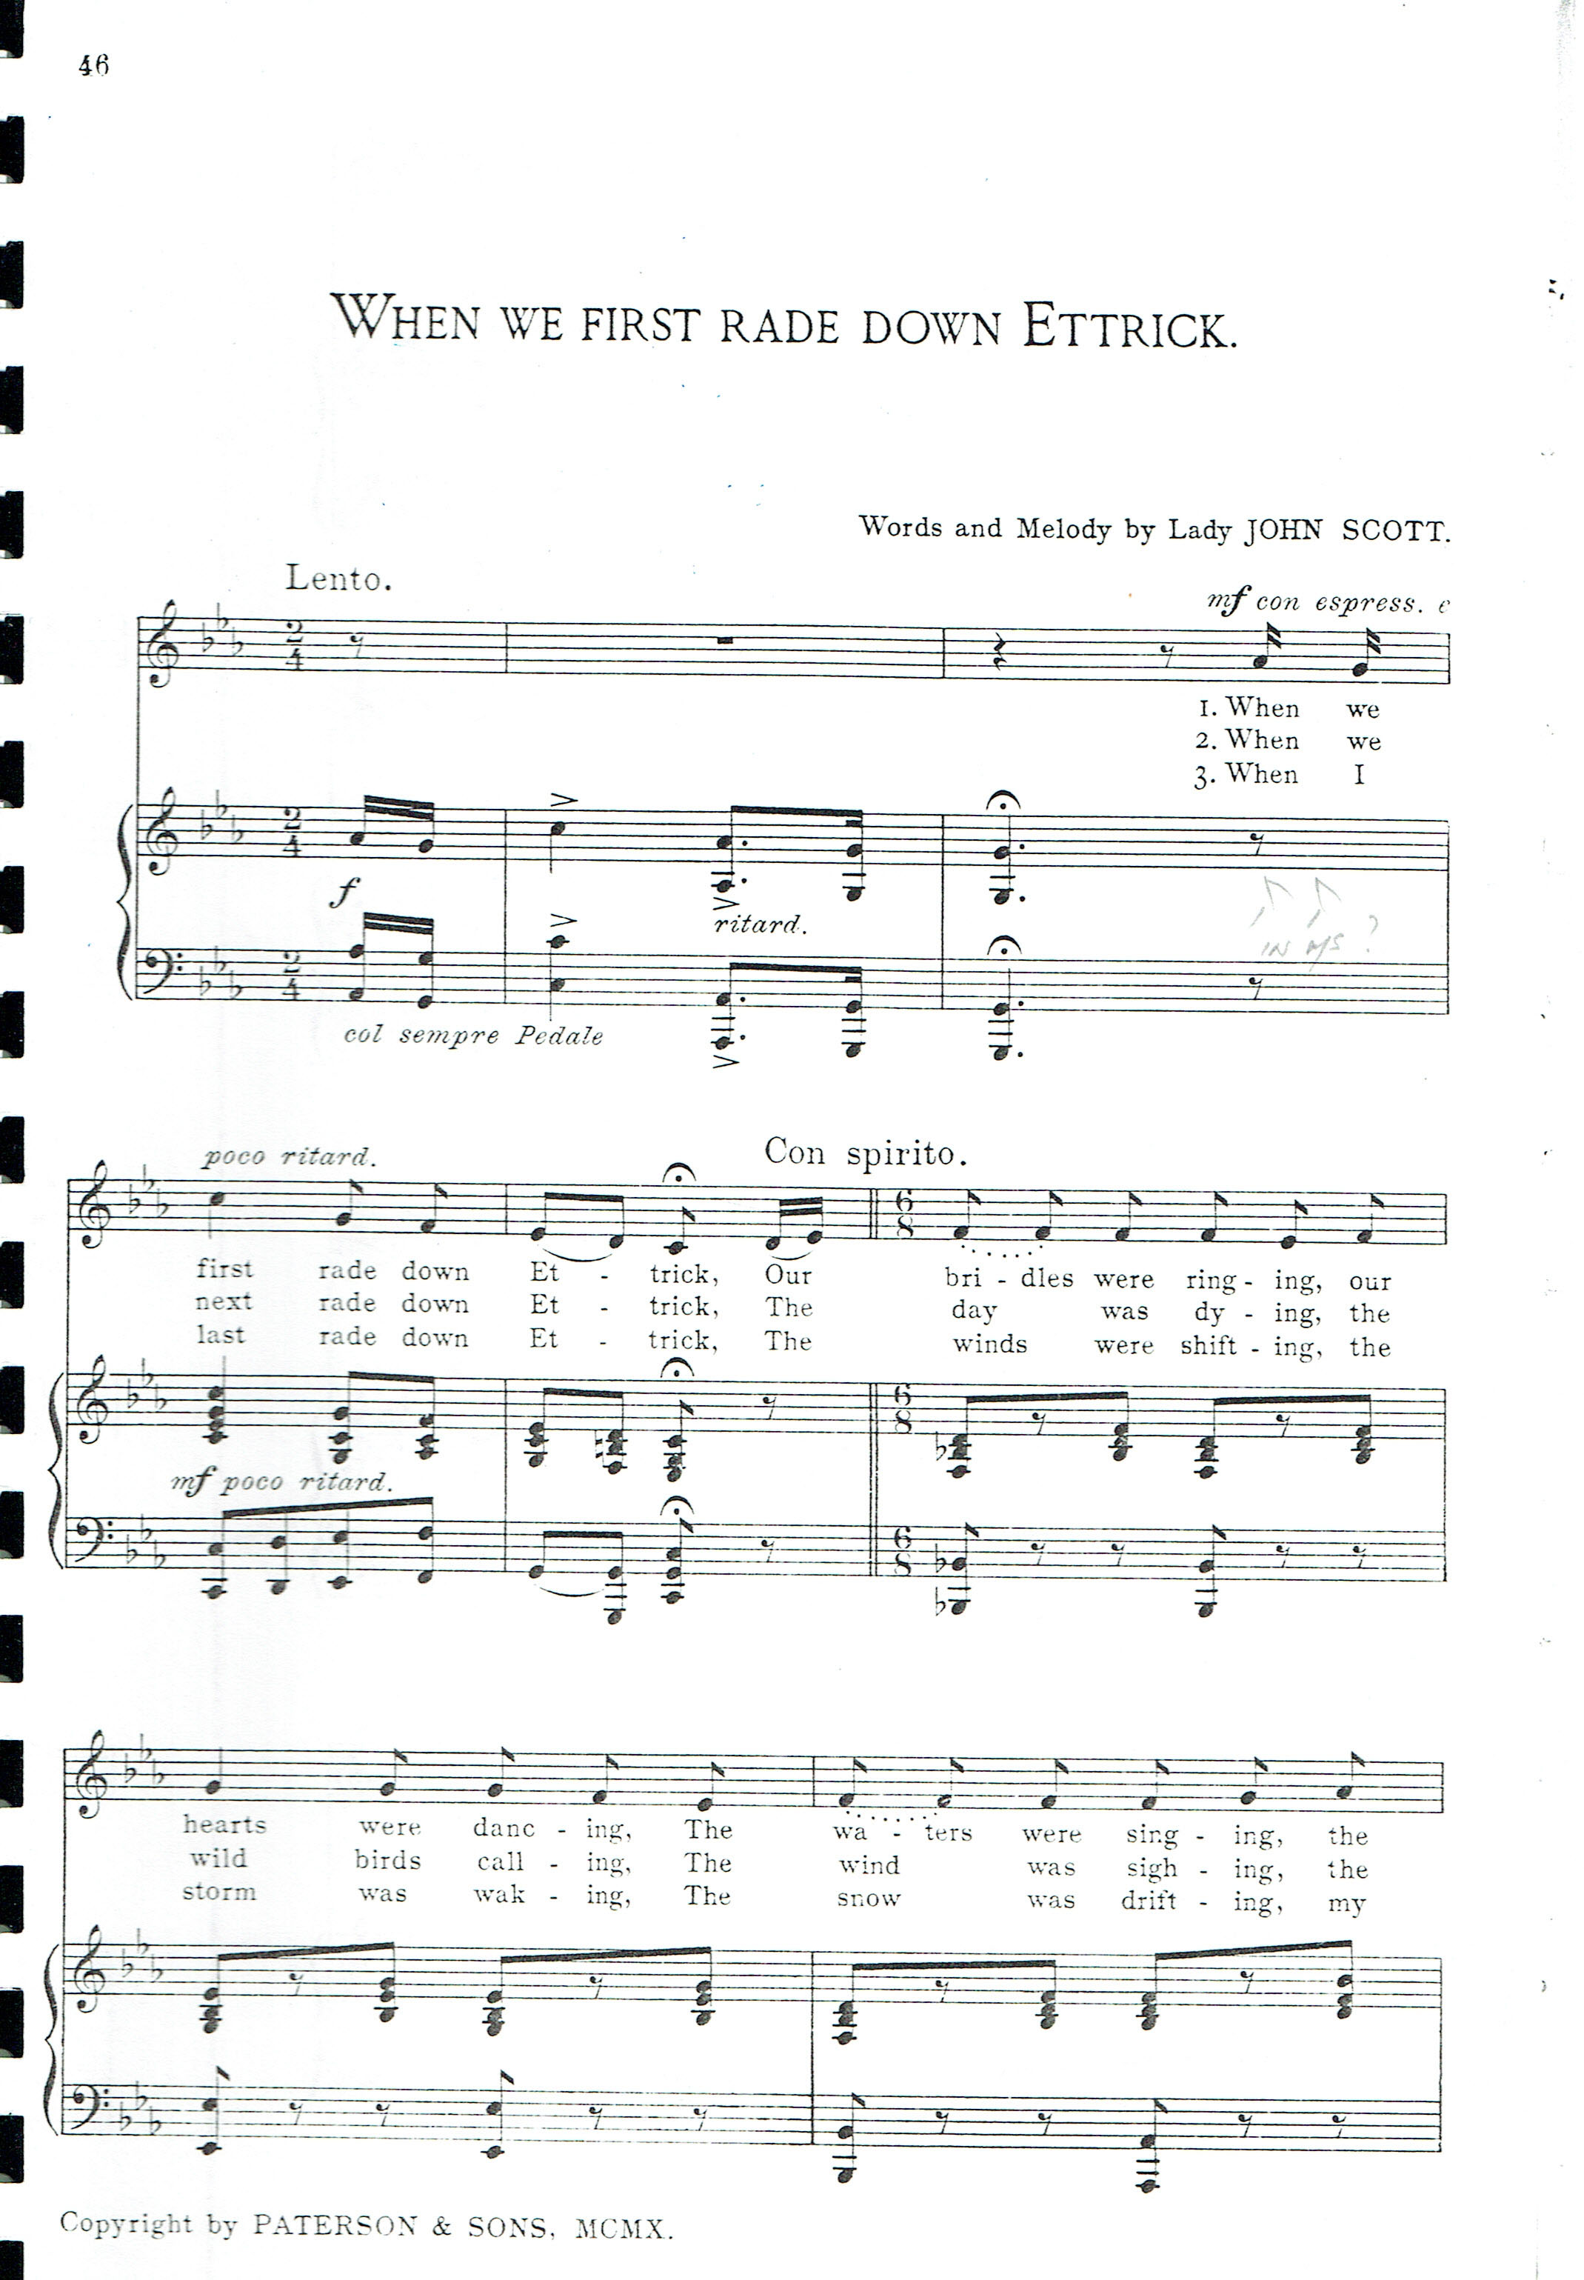
Ettrick

Slide 17
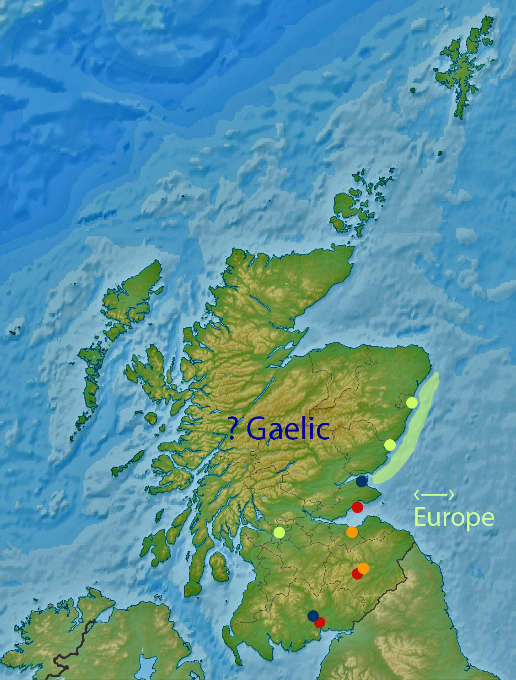
Musical time machine!
3 Scots songs
Late C18
Early C19
Mid C20
C20
C19 |  |  | |
 |  |  | |
 |  |  | |
C18 |  |  | |
 |  |  | |
C17
C16
 |  |  | ?
 |  |  | ?
C15 | ↓ | ↓ | ↓

Slide 18
Thank You

